Slide 1
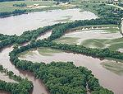
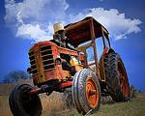
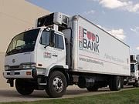
USDA Programs in the Local Food Supply Chain
Land
Conservation
Production
Aggregation/
Distribution
Processing
Markets /
Consumers
Business and Industry Guaranteed Loans
Community Facilities Loans and Grants
Rural Business Enterprise Grants
Rural Business Opportunity Grants
Value-Added Producer Grants
Local Food Promotion Program
Farm to School Grants
Senior Farmers’ Market Nutrition Program
WIC Farmers’ Market Nutrition Program
Community Food Projects Competitive Grants
Farmers Market Promotion Program
Specialty Crop Block Grants
Conservation Reserve Program
Agricultural Conservation Easement Program
Conservation Stewardship Program
Environmental Quality Incentives Program
Farm Loans
Farm Storage Loans
Organic Cost Share
Environmental Quality Incentives Program (hoop houses/high tunnels)
Business and Industry Guaranteed Loans
Community Facilities Loans and Grants
Rural Business Enterprise Grants
Rural Business Opportunity Grants
Local Food Promotion Program
Specialty Crop Block Grants
Research, Education, and Technical Assistance Programs – all along the supply chain
Rural Cooperative Development Grants
Small Business Innovation Research
Risk Management Education Program
Federal State Marketing Improvement Program
Conservation Technical Assistance
Beginning Farmer and Rancher Development Program
Sustainable Agriculture Research and Education Program
Agriculture and Food Research Initiative
www.usda.gov/knowyourfarmer

