Slide 1

Salad Bar 101
Diane Chapeta
Illinois Farm to School Network

Slide 2
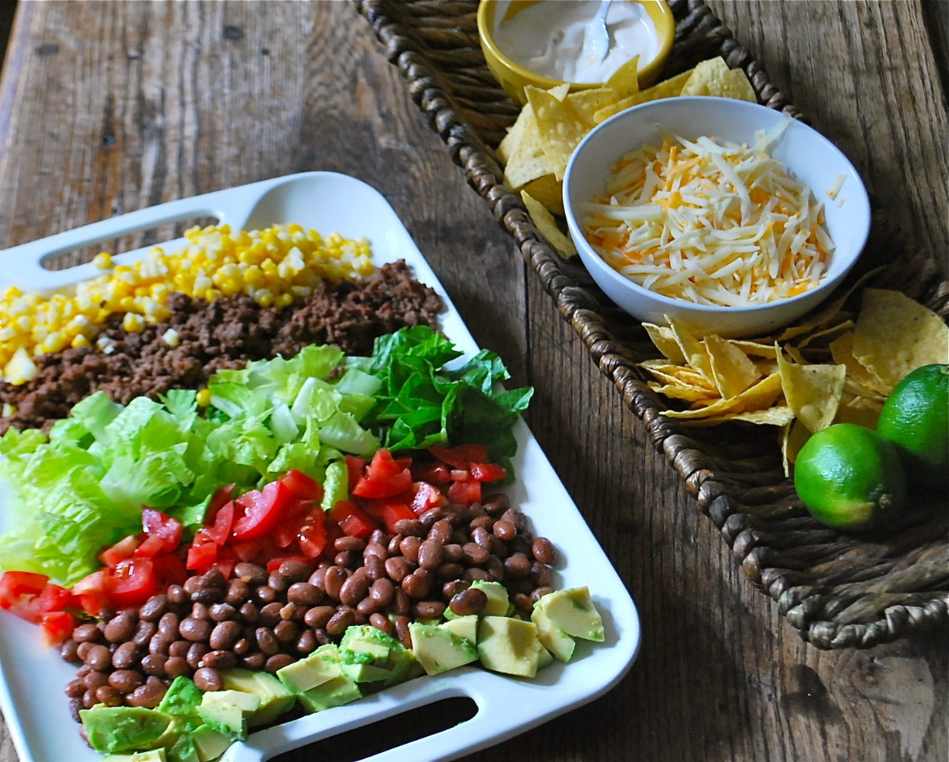
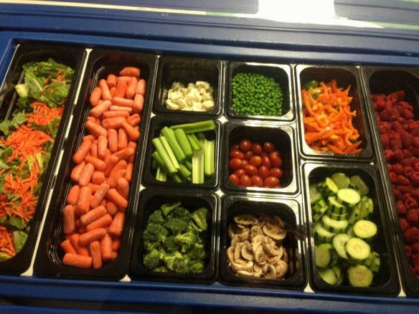
No two salad bars are alike!
Full Meal Salad Bar with protein and grains
Fruit and Veggie Only Salad Bar

Slide 3


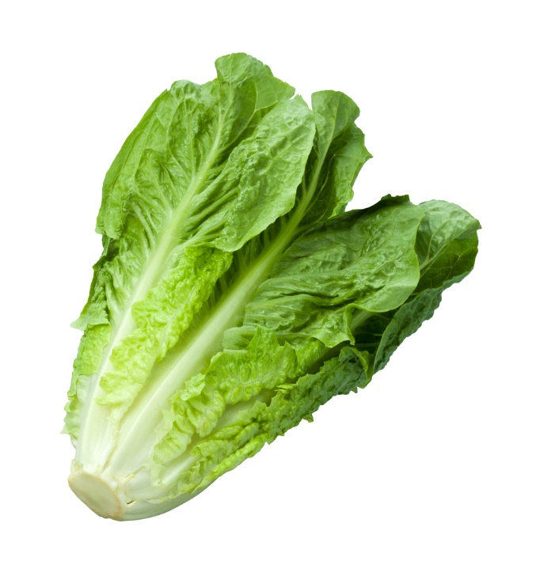

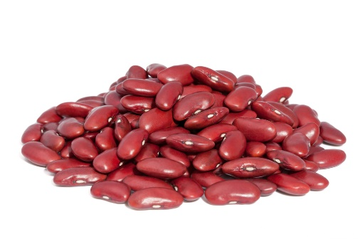
Vegetable Sub-Groups for School Nutrition Programs
Orange/Red Required
Other
Dark Green Required
Starchy Limited
Beans/Peas
Notes:
How presentation will benefit audience: Adult learners are more interested in a subject if they know how or why it is important to them.
Presenter’s level of expertise in the subject: Briefly state your credentials in this area, or explain why participants should listen to you.

Slide 4
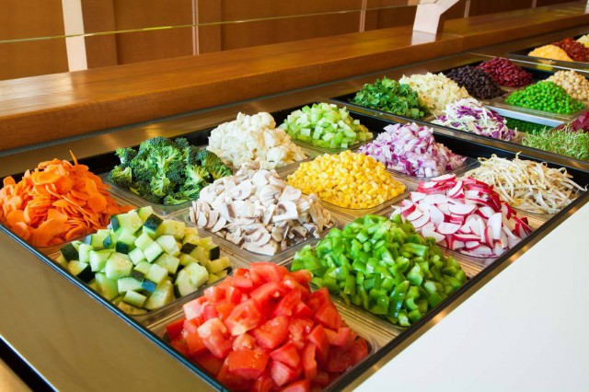
Salad bars can be used as a complete reimbursable meal if:
A protein and a grain are offered on the bar.
The location of the salad bar is prior to Point of Service (POS).
If a school is not able to position the salad bar in a location prior to the POS, State agencies may authorize alternatives to the POS lunch counts, such as stationing staff at the end of the salad bar, to ensure each student leaves with a reimbursable meal.
Schools must identify, near or at the beginning of the serving line(s), the food components that constitute the reimbursable school meal(s).

Slide 5
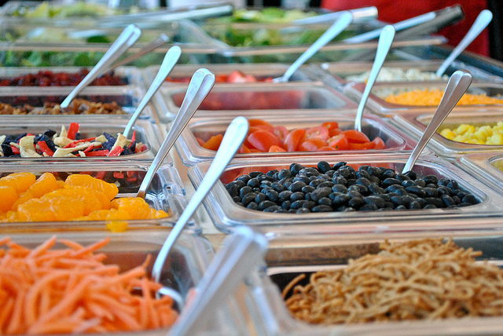
Approximating Daily Costs for Salad Bar Items

Slide 6
The formula for the average cost per serving can be broken into two price groups: low and high. If you prefer, you can set up three price groups; low, medium and high to be more exact in your calculations. To create produce groups, list all produce items that fall in each range with price points. Then you can determine how many items from each group you can add to the salad bar to be cost effective. Please add any labor costs into the price point for items needing extra cutting or handling. Also, consider item popularity and track usage on all salad bar items. Review and make any final adjustments with seasonal pricing, as it occurs. Refine daily selections based on usage, serving size effectiveness and popularity. Color coding vegetable offerings in your list can help you incorporate USDA required color categories in daily/weekly offerings. Once you have a color coded list of allowed daily items, your staff can set up the bar with little direction from you. | EXAMPLE High Price Group .24 per serving List the number of items at, or over, the high price point EXAMPLE: 10 items, 3 price points 4@.24 2@.31 44@.28 Price points: .24+.31+.28= .83 .83 divided by 3 Estimated average cost: 27.6 round up 10 items@ .28 per serving aver. (Actual aver. cost is: .286 per serving) Review final daily costs every week. Once the daily costs on a new salad bar have leveled out, review monthly to be sure you are within your budget limits for the salad bar. EXAMPLE: HIGH Price Group List: aver. .28 per serving (color coded) Broccoli, Artichoke, Spinach, Asparagus, Zucchini, Red Bells, Avocado, Yellow Bells, Sugar Snap Peas, Cherry Tomatoes. Yellow=starchy limited Red=required red/orange group Green= required dark green group Brown= Beans/peas group | EXAMPLE Low Price Group .13 per serving List the number of items at, or between, the low and high price point. EXAMPLE: 12 items, 3 prices 7@.16 44@.20 1@.19 Price Points: .16+.20+.19= .55 .55 divided by 3= Estimated average cost per serving: .183 round down Estimated per serving cost: 12 @ .18 serving (Actual aver. Cost: .175 per serving) Review final daily costs every week. Once the daily costs on a new salad bar have leveled out, review monthly to be sure you are within your budget limits for the salad bar. Low Price Group List: aver. .18 per serving (color coded) Kale, Corn, Lentils, Carrots, Romaine, Green Peas, Cucumbers, Jicama, Beets, Kidney Beans | Item Usage Calculation: Based on my budget of $_______ per day, and based on popularity of the items, I can afford to utilize 4 items from the High group and 10 from the Low group daily, allowing 2 salad bar servings per student, per day. Remember! Salad bar usage can increase and wane depending on lunchtime activities, menus, field trips, weather, etc. Calculating the average waste factor into your costs is an effective way to stay within your budget. Food waste numbers for specific items can be logged over one month’s time and then averaged. Apply the average waste cost per serving to the item cost. This will increase item costs, but will also give you a firm cost expectation of a salad bar item.

Slide 7
Weekly Salad Bar Items Master Prep List (6 foot bar)
*Staff be sure to prep 2 red/orange and 2 Dark Green items daily. Follow estimated quantities chart when prepping items, creating back up amounts and making side salads.
GROUP 3 LOW COST
Prep SIX to TEN items daily
Kale
Corn
Lentil
Carrots
Romaine
Green Peas
Cucumbers
Jicama
Beets
Kidney Beans
Cabbage
Green Bells
Celery
Kohlrabi
GROUP 2 MID COST
Prep FOUR to SIX items daily
Green Beans
Butternut Squash
Bean Sprouts
Purple Potatoes
Tomato Juice
Soy Beans
Tofu
Wax Beans
Sweet Potatoes
Brussel Sprouts
Mushrooms
GROUP 1 HIGH COST
Prep TWO to FOUR items daily
Broccoli
Artichoke
Spinach
Asparagus
Zucchini
Red Bells
Avocado
Yellow Bells
Sugar Snap Peas
Cherry Tomatoes

Slide 8
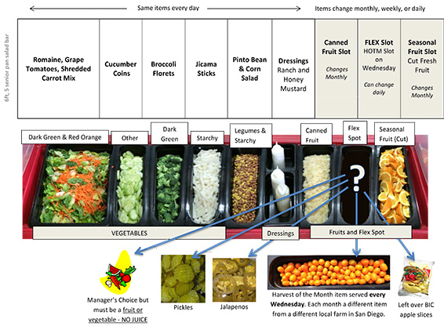
CHOOSING THE RIGHT SELF-SERVICE BAR
Before purchasing a self-service bar, ask yourself the following questions:
What type of bar is it?
  Is it a salad bar?
  Is it a fruit and vegetable bar?
  Is it a toppings/fixings bar to finish off sandwiches, tacos, or other entrée choice?
Where will you put it?
  Will it serve all lines?
  Is it part of the reimbursable meal and therefore in front of the point of sale?
  Will you need to fit it through a door when not serving? If so, is it easy to move?
  How much will it hold? o
  Do you have room for 4, 5, or 6 wells?
  Do you need to order dividers so you can use smaller pans?
Where will you put it? Flow patterns? Ease of access?
How easy is it to clean?
  Do the breath guards/sneeze guards flip up?
  Is there a drain?
Is it refrigerated and/or lighted?
  Do you have electrical where you want to place and store the bar?
  How long is your food out? Can you use the food safety time and temperature rule?

Slide 9
Self Service Bar Tips: SETTING UP & MONITORING AND OBSERVING
Place items on both sides so no student has to reach over.
Use attractive pans, utensils, and labels.
Use a ½ size 2-inch deep plastic cold food pans or metal steam table pans so serving utensils do not fall go into the food.
Use 1/6 or 1/9 size hotel pans for items that are not used in great quantity, such as cilantro.
Use full size 6-inch deep hotel pans only for items that do not need utensils, such as bananas or a wrapped product.
Use empty pans or pan covers to cover empty spaces. Empty pans are great for holding tongs. Or you can use the empty space to repeat an item that takes longer to self-serve.
Change out serving utensil with a clean utensil each lunch period or, if continuous service, every half hour.
Change out containers as needed. Avoid adding food on the line from a can or a bag.
When only a little product is left, bring it back to kitchen, place in the smallest container needed and refrigerate. Save in case you need it for the last line.
Dispose of any cut or peeled fruits and vegetables, including canned, used on serving line at the end of the total serving time. To minimize waste, use smaller containers and replenish as needed to reduce the amount that needs to be discarded.
Squeeze bottles of salad dressing are easier for children than. They do not need to placed under the breath guard. Fill only ⅓ to ½ full so you can have more bottles without wasting product. Dispose of product daily.
Follow the food safety guidelines for commercial bottled sauces or cryovac bags, such as hot sauce, ketchup, or dressings.
During service, do not use any cleaning sprays. Wipe up only with an approved cleaner or quat.
During break in service, roll out a cart with fresh product and utensils on top, a bucket for scraps, and cleaning buckets on bottom of cart.
Immediately remove a container or utensil that has been contaminated. Introduce the subject of the presentation.
Determine the rules for self-service. How much or how many? Will it be unlimited?
Give good instructions to students on how to go through the line. Ask cafeteria monitors to assist children as needed.
Observe the students’ use of utensils. Make sure utensils are easy to use. Example: A spaghetti server is great for carrots. When students use tongs, the carrots are likely to spring out and onto the floor. Place items on both sides so no student has to reach over.
Notes:
How presentation will benefit audience: Adult learners are more interested in a subject if they know how or why it is important to them.
Presenter’s level of expertise in the subject: Briefly state your credentials in this area, or explain why participants should listen to you.

Slide 10

Add local to your salad bar.
Incorporating local items will add interest and can be used as the basis for a promotion.
Seasonal fresh items are available through November. Many local items are available through DOD purchasing.
Storage crops are available through March.
Value-added frozen, dried or canned items are also available year-round.
Incorporating value-added local to salad recipes lowers local product costs.
Creating a “buzz” over local veggies on the bar can be as easy as posting farm identification above the item.

Slide 11
Tools and Systems that work.
A Guide to Salad Bars in Schools-MN http://www.health.state.mn.us/divs/hpcd/chp/cdrr/nutrition/docsandpdf/guidetosbinschools.pdf
The Lunch Box Salad Bar Guide- http://www.thelunchbox.org/assets/uploads/documents/The_Lunch_Box_Salad_Bars_Guide.pdf
Whole Kid’s Foundation- Salad Bars https://www.wholekidsfoundation.org/schools/programs/school-salad-bars

Slide 12

Thank you!
Questions? Contact us…
http://illinoisfarmtoschool.org/
http://illinoisgreatapplecrunch.com/
-Placeholder for HOM website-

