Slide 1
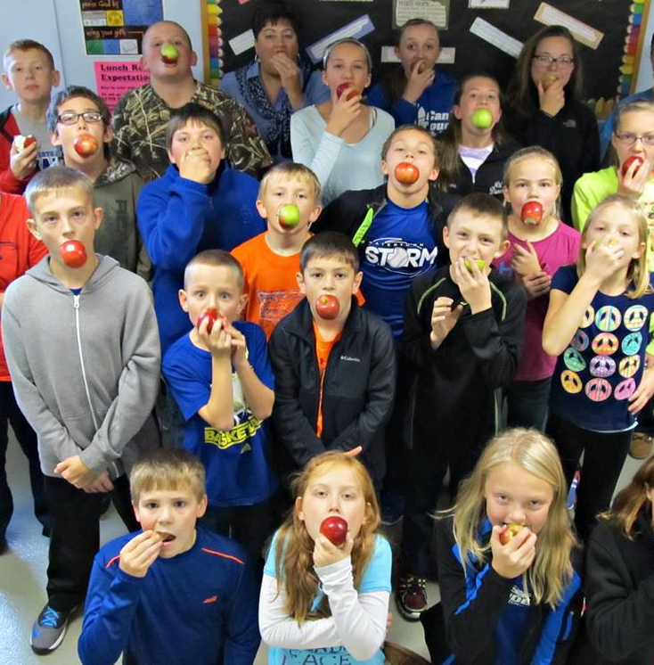


Great Apple Crunch
October 13, 2016 at noon!
Mini Training for School Professionals
Hosted by the Illinois Farm to School Network

Slide 2



Great Apple Crunch in Illinois
2016
This is our second year participating in the Great Apple Crunch! Over 90,000 students in Illinois ate local apples in 2015.
Students across the Midwest will participate and all crunch into apples at noon
The organizing partners have been the Illinois Farm to School Network, Agriculture in the Classroom, and the Illinois Farm Bureau. The Crunch is supported by ISBE and the company FarmLogix.

Slide 3

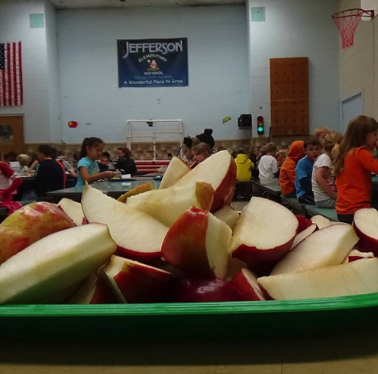
What is the Great Apple Crunch?
This fun day is all about getting local foods in schools, and celebrating the harvest!
The Great Apple Crunch is a one day effort when students will ‘crunch’ into local apples and schools will celebrate Midwestern farms. It’s also a day to do additional nutrition lessons with free materials provided by Agriculture in the Classroom of Illinois.
The Crunch is in it’s fifth year in states such as Wisconsin, Michigan, Minnesota and Ohio.
For the second year, we are hoping to have over 200 districts participate by purchasing local apples. We also hope to have 100 schools participate in the nutrition education and media activities.
October 13th, 2016
Notes:
Join students of all ages, along with individuals across the Midwest, in celebrating National Farm to School Month by crunching into locally grown apples at NOON on Thursday, October 13, 2016.
This collective crunch encourages healthy eating and supports farm to school and other local food purchasing initiatives throughout the region. It’s also a fun way to connect food and nutrition to all kinds of classroom curricula – from science to art! The Great Apple Crunch provides your school, district, county or organization the framework to host a successful local food promotion event this October.

Slide 4


What is the Illinois Farm to School Network?
The IFSN works statewide to highlight innovative projects and provide informational support for schools and organizations who want to grow healthy communities through the lens of farm to school. The network provides training, connects partners, and shares resources about all aspects of farm to school.
What are the goals of the farm to school network?
We believe that Farm to School programs will empower children and their families to eat more locally grown fruits and vegetables while also strengthening local economies. The Illinois Farm to School Network will facilitate information sharing, advocacy and networking to strengthen new and existing Farm to School programs. Our vision is that every school in Illinois will participate in Farm to School by 2020.
Notes:
We will add you all to our mailing list (feel free to unsubscribe), keep in touch about the crunch and other events, plus crunch 2016

Slide 5
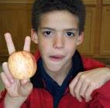
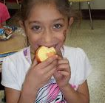
Get students excited about healthy food!
Teach kids of all ages about agriculture.
Support Illinois farmers – some of whom are selling to schools for the first time.
Why local apples?

Slide 6
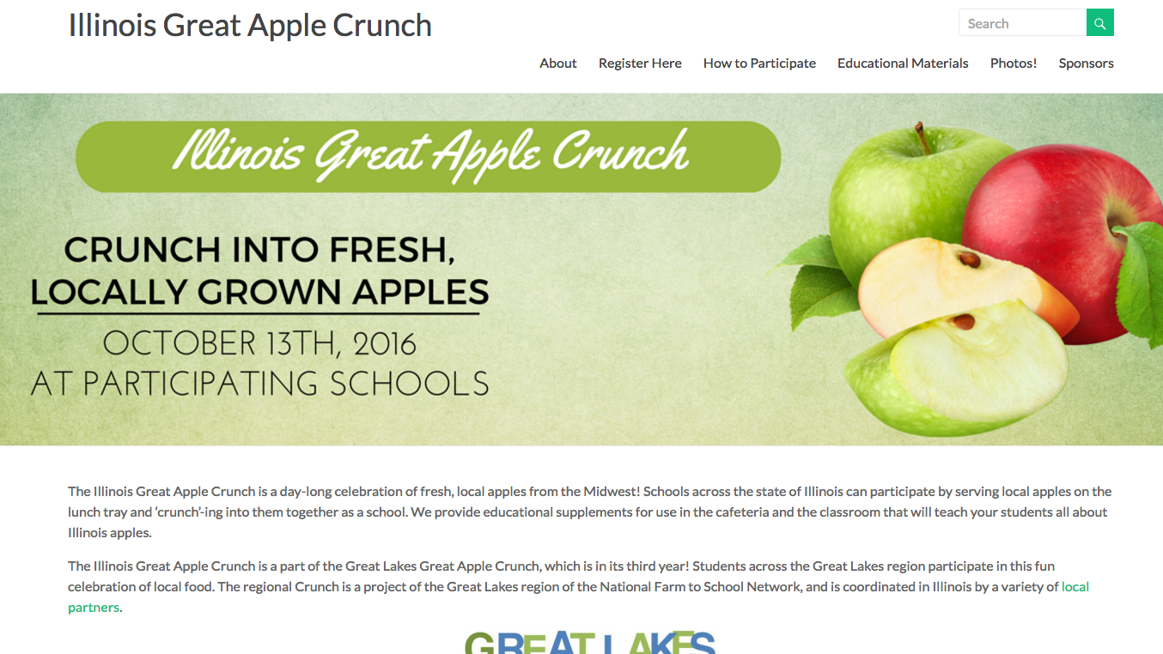
New website makes it easy!
Register your school online:
www.illinoisgreatapplecrunch.com
Activities and more online
Submit photos here after the Crunch!

Slide 7
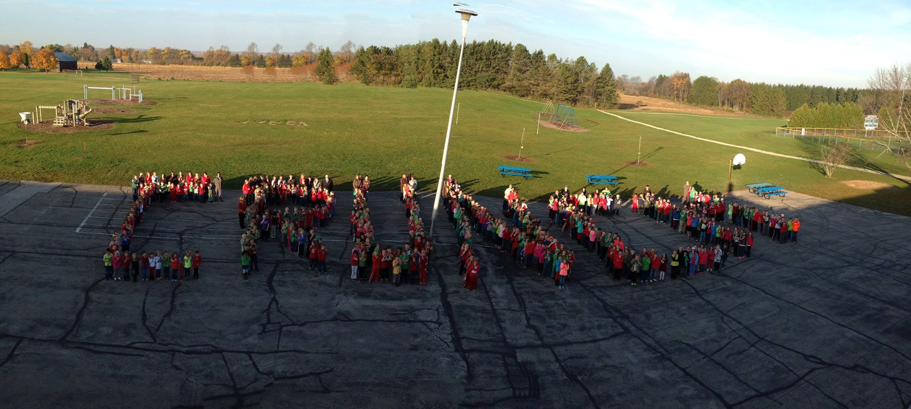
What can schools do to celebrate?
Pick and choose what options will work best in your school and with your students.
Crunch into your apples at noon!
  Take a photo or video of your students crunching into the apples.
  You can focus on just your cafeteria group at that time, or gather as many students as you can into the gym or another space for a crunch photo.

Slide 8
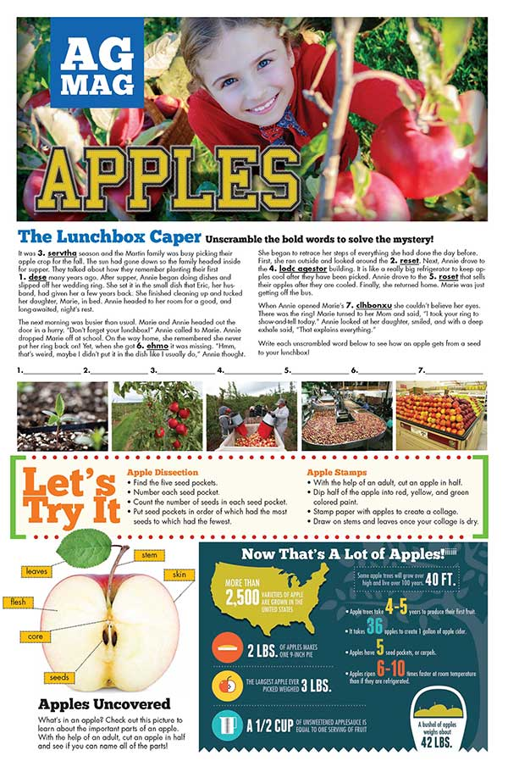
What can schools do to celebrate?
Use nutrition education activities from Agriculture in the Classroom during your school day.
They include information on why apples are good for us, how farmers grow apples, and what other careers are related to growing apples.
Notes:
On the website

Slide 9
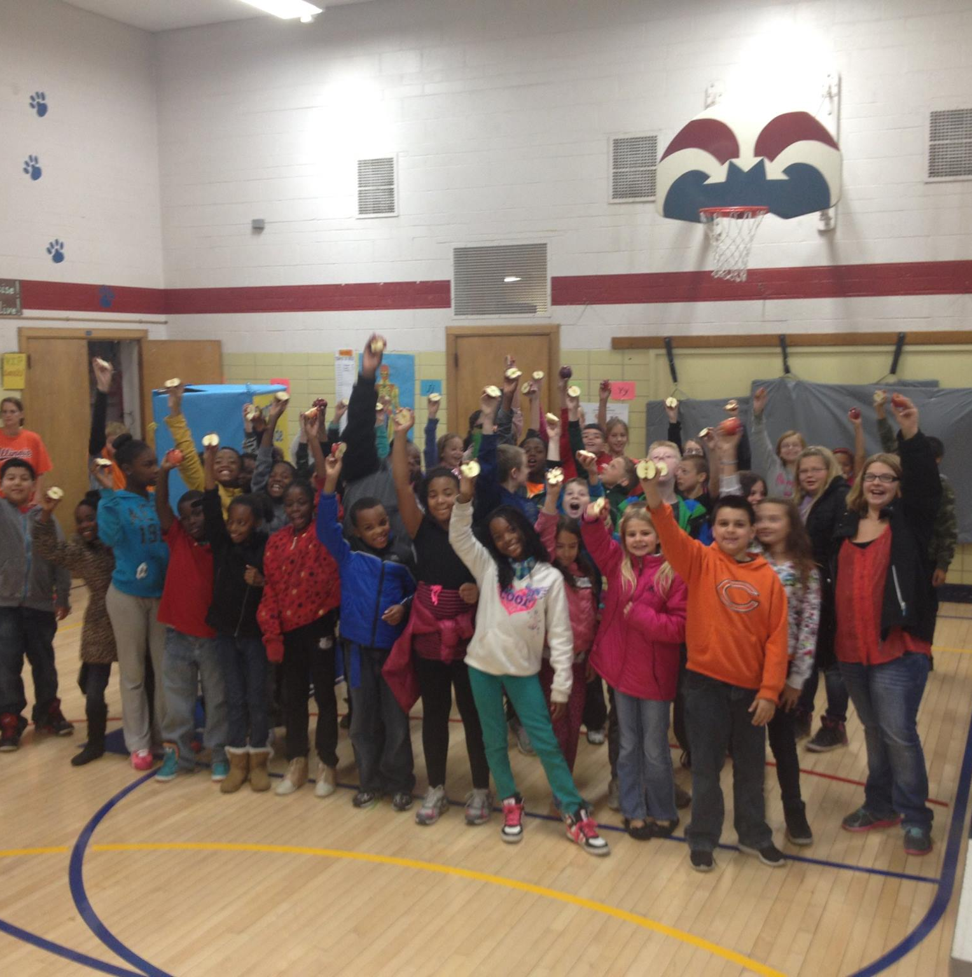
What can schools do to celebrate?
Take photos!
Post them on facebook and our website!
Facebook.com/greatlakesgreat applecrunch
Illinoisgreatapple crunch.com

Slide 10

Here are some ideas for additional fun activities:
Make a Crunch-o-Meter to judge the volume of student crunches. Pick the crunch winner!
Encourage all students to wear red for Crunch day.
Take some classes to a Pick Your Own orchard for Crunch Time. Students could even harvest apples for the whole school to crunch.
Taste test different apples varieties, and vote on your favorite.
Read books about apples like Johnny Appleseed, Apple Pie ABC, Apple Picking Time, One Green Apple or The Apple Pie Tree
Plant apple trees with students in your school garden.
Write a song about the Crunch, and include a pause in the song where everyone crunches into their apples. Ask students to write the song.

Slide 11
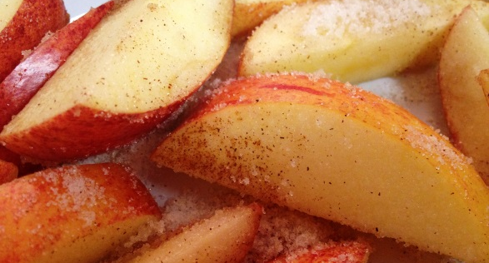
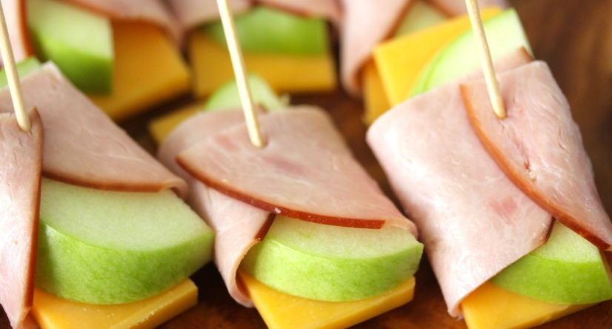
Serve apples in the classroom or do cafeteria taste tests
There are lots of ways to creatively serve apples. You can crunch into them at the cafeteria at noon and then make fun recipes with them in the classroom.
This is a great way to engage PARENT VOLUNTEERS. They could donate the food or their time to create these easy classroom bites.
We are providing our Mindful Tasting worksheet for students to learn how to describe the flavors they encounter
Notes:
Cinnamon apples – combine lemon juice and sliced apples, then add cinnamon and a small amount of sugar.
Ham and cheese apple wraps - slice apples, cut cheddar, cut a small amount of deli ham and wrap it over the apple and cheese.

Slide 12

Hang the Apple Crunch Poster in your cafeteria!
Many schools will receive a poster in the mail during the third week of September. They will be mailed to school food service directors, along with more information about buying local apples for the day.
During October, if your school has not received a poster but you plan to participate, please reach out to Lydia at the Illinois Farm to School Network or to your local Agriculture in the Classroom educator. They will provide you with a poster and Apple Ag Mag.

Slide 13
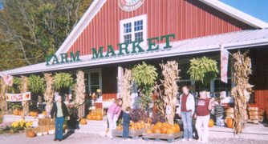
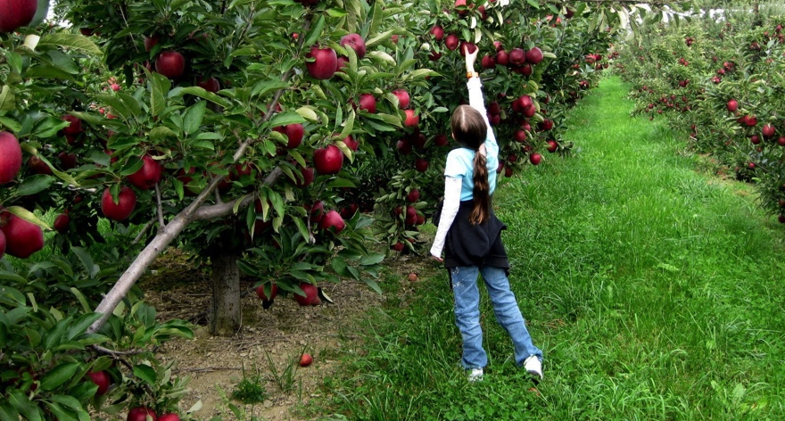
Visit a local apple orchard
Farm field trips are fun for students of all ages!
If your school is close to an orchard, contact them to see if they allow school groups and/or offer additional educational activities
This is a great way for students to learn how apples grow – it’s a lot of work! They can also learn about agricultural careers.

Slide 14


Get the media involved!
Send a press release about the Crunch to your local newspaper – we have a template for you to use!
Invite your local news channel to the Crunch
You can showcase your school’s programs (perhaps your garden?) and highlight Farm to School Month
This will also show your community how much students love eating healthy food and food from the cafeteria

Slide 15


How to purchase local apples for the Crunch – for public schools
Most food distribution companies in Illinois know about the Great Apple Crunch
School food service directors across the state will receive information from the Illinois Farm Bureau about how to purchase local apples in order to participate in the Great Apple Crunch
If your school food service director has not received this information, it may be due to availability of apples in the area
Use DoD Fresh? Illinois apples may be in your buying guide. More information about this will be available closer to Oct. 22nd.
If you are located in Northern Illinois, particularly, school food service directors are encouraged to ask their food service provider company if locally grown apples will be available for purchase on the day. FarmLogix, a local food logistics company, is working with large, Northern IL distribution companies to get Michigan and Wisconsin grown apples in the market for October 22, 2015

Slide 16


What if you’re a private or parochial school – or you are having trouble buying through your distributor?
If you want to buy directly from a farmer, there are lots of options available. Public schools may need to engage in a competitive bidding process for this, while private schools that don’t use federal funds may not have to.
Check out Prairie Bounty, a website created by the Illinois Specialty Growers Association that uses data from Market Maker
This website will show you what apple growers are closest to your school: http://www.specialtygrowers.org/prairie-bounty.html

Slide 17


Thank you!
Lydia Mills
Farm to School Coordinator
lydia@sevengenerationsahead.org
708-628-4503
Illinois Farm to School Network
Based out of..
Seven Generations Ahead, Oak Park IL

