Slide 1

Notes:
Hello and welcome to our Mighty Mini Video on Illinois Harvest of the Month, presented by the Illinois Farm to School Network. My name is Diane Chapeta. I am a former Wisconsin school nutrition director, and the current network coordinator for the Illinois Farm to School Network.
I will be your host today as we take a look at this new and exciting program.
All of our Mighty Mini Videos are available on our website in a PDF format, as well a presentation format.

Slide 2

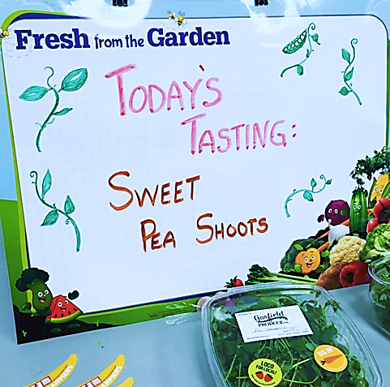
What is the Harvest of the Month program all about?
Celebrating local food
Teaching kids about seasonal eating
Peaking interest in other farm to school activities
Making it easy for school to bring food education into the cafeteria and the classroom
It’s a great place to get started with farm to school!
Nationwide programs
Notes:
The Illinois Farm to School Network has adopted the Harvest of the Month program as a simple way for schools to try their hand at Farm to School. This program is flexible and easy to utilize.
Each month, participating schools source the local/regional fruit or vegetable listed on the annual Harvest of the Month calendar. Each month will have a spotlight item, and an alternate item. Each school decides its level of participation for the month, whether it be a cafeteria tasting, a fresh feature on the salad bar, an added item on the lunch menu, or perhaps a classroom or garden lesson. Printed materials, recipes and lessons are available on our website for each months harvest selection.
The monthly spotlight and alternate fruit or vegetable items are available to procure through a variety of methods including DOD purchases.

Slide 3

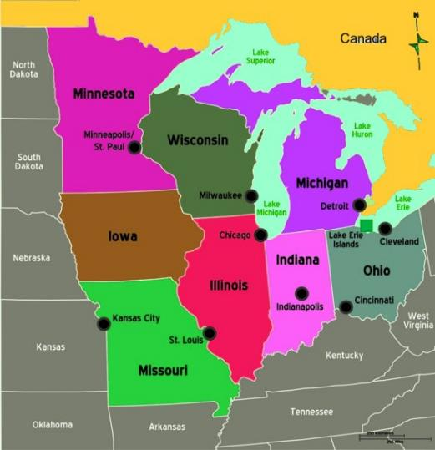
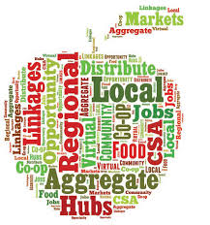
Regional Defined: 250 miles
Notes:
Illinois Harvest of the Month features fresh items which can be sourced either locally, or regionally. We promote Illinois products and our states’ specialty growers first. However, we understand the difficulties schools face when local options are limited, or unavailable. This map explains our definition of regional for this program. By allowing regional sourcing, we give Illinois schools an opportunity to find the best fit for their area.
For great Illinois sourcing options check out our Mighty Mini Video titled Sourcing Locally!

Slide 4
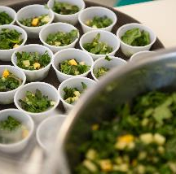

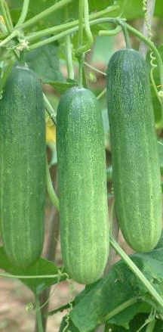
Objectives and Goals of Illinois Harvest of the Month
Objective 1: To incorporate regional/local fruits and vegetables into student’s diets through lunch, breakfast, snack and/or tastings during the school day.
Objective 2: To increase food education and awareness for k-12 students during the school day.
Objective 3: To expose student’s families to new foods and methods of preparation.
End Goals: By exposing students to Farm to School programing, we improve food knowledge and exposure to healthy food. Thus, we promote and encourage healthy eating habits in k-12 students.
Notes:
At Illinois Farm to School Network, we believe that healthy, active students perform better in school. All of the objectives of Illinois Harvest of the Month focus on improving students’ diets and encouraging food and nutrition education. By exposing students and their families to new foods and preparation methods, Illinois Harvest of the Month improves exposure to, and the knowledge of, fresh, wholesome foods. By doing so, we promote and encourage healthy eating habits in K-12 students.
It’s a win/win scenario.

Slide 5
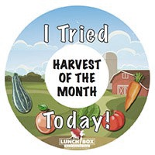

Benefits of Harvest of the Month
Increased ability of farmers to sell food to schools
  How?
Increased consumption of fruit and vegetables in children
  Survey-based evidence
Building up the market for institutional sales
Easy way for the Illinois Farm to School program to collect more data on local purchasing and student knowledge, attitudes and behaviors about local food
Convenient and cost efficient way for schools to begin local procurement
Notes:
The benefits of Harvest of the Month are multi-layered. When we encourage schools to purchase locally and regionally, we help to develop the marketplace for local and regional farmers and producers.
We also encourage students to change their eating habits, which creates added interest in fresh fruit and vegetables. Increased consumption of fresh fruits and vegetables changes the attitudes and behaviors of school-aged children. And, of course, this program is an easy way for schools to begin to procure locally.

Slide 6
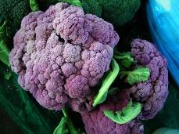

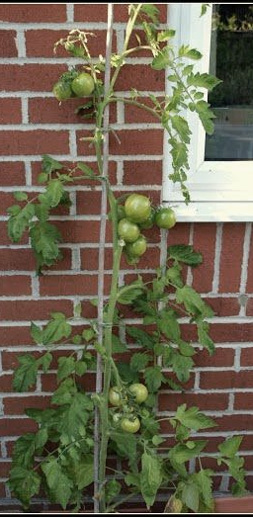
Illinois Harvest of the Month Pilot Year
2016-2017 School Year: Pilot Program
  School districts in Kane Co, Springfield area and Rockford will be the first participants
  Other school districts can participate this coming school year if they are willing and able
  Sourcing thru the DOD FFV program and independent produce distributors
Notes:
In the 2016/2017 school year, Illinois Harvest of the Month will be featured in multiple schools in Illinois. These pilot schools will receive assistance from the Illinois Farm to School Network as they develop the program in their districts. Information will be gathered on best practices prior to the state-wide program release. The 2017/2018 Illinois Harvest of the Month program will be open to all districts in Illinois.
If an Illinois school wishes to be part of our pilot year, and they are willing and able to participate, contacting our office is the first step.

Slide 7

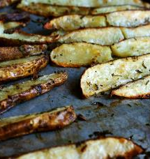
What Does Participation Look Like?
Participation will fit each school’s needs and abilities - they choose!
Cafeteria celebrations
Classroom or cafeteria tastings
Harvest of the Month items on hotline menus and/or salad bar menus
Harvest of the Month items on breakfast menus
Harvest of the Month in the school snack program
Classroom lessons, craft, or garden activities
Invite school families to participate at home
Incorporate participation of local produce stores, bodegas and grocers
Promoting Harvest of the Month on menus, in the media and in the community
Student farm visits and farmer visits to the classroom/cafeteria
Notes:
One of the benefits of Illinois Harvest of the Month is the versatility of participation for school districts. Schools come in all shapes and sizes. Harvest of the Month can be utilized for any size school, in any locale. Participation should be based upon the strengths of the school meal program, and availability of facilities, staff, classroom time, etc. in each school. By determining the best method for participation, schools can incorporate those activities which will enhance the school meal program.
What could be simpler?
Please take a moment to understand the many ways schools can participate in this program listed on this slide. As always, copies of the Mighty Mini Video presentations are available in a PDF version on our website.

Slide 8

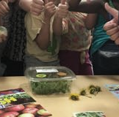
Tools and more…
Monthly food poster and art
Dedicated website page for each month
Scalable recipes w/ nutrition breakdowns for food service menus
Printable recipe cards for school families “at home” participation and education
Book list for teachers to read in classrooms
List of activities by grade level
Crafts and art projects
Garden activities
Short lesson plans
Drag and drop wording for school menus, a.m. announcements and home newsletters
Expert assistance for procurement and application
Notes:
The Illinois Farm to School Network has a tool box loaded with information and practical tools for participation in Harvest of the Month, each and every month. From monthly posters, to drop in language and food service recipes, it’s easy to build your program. Levels of participation are varied and can take on many forms.
All tools will be available online on the Illinois Harvest of the Month website at: HarvestIllinois.org

Slide 9
EXAMPLE GAME: Bare Pantry
Divide into 4 groups of 10 people.
On a table are ingredients. Every group has to go up and choose two items that they will use to make a recipe.
Every recipe can utilize their two items, plus any of the items in the PANTRY LIST.
Each team has to write a list of meals that they could make with their items. You don’t need to include every item, but you do need to include the Harvest of the Month food!
At the end of three minutes, each team reports how many dishes they created and share their best one. At the end of the round, every team has to choose one item to pass to the next team for the second round.
PANTRY LIST:
Harvest of the Month food: Spinach
Cooking fat (oil, butter, etc)
One meat or meat alternate (choose chicken, pork, egg, beans, tofu or beef)
One grain (choose between rice, pasta or bread)
Knife
Cutting Board
Bowl
Access to a stove and an oven
Notes:
This is an example of a classroom game for grade 5-12 students. Bare Pantry encourages students to use critical thinking when designing recipes and building menus around the Harvest of the Month item using two chosen ingredients and items available on a pantry list. Teams work to incorporate their ingredients into as many recipes and menus as possible in the time allotted. The game takes on a “pass to your neighbor” context in the following rounds. As the ingredients become intermixed the challenge to create recipes and menus has students thinking beyond the norm. The resulting recipe and menu ideas can be shared at home or with school food service.

Slide 10
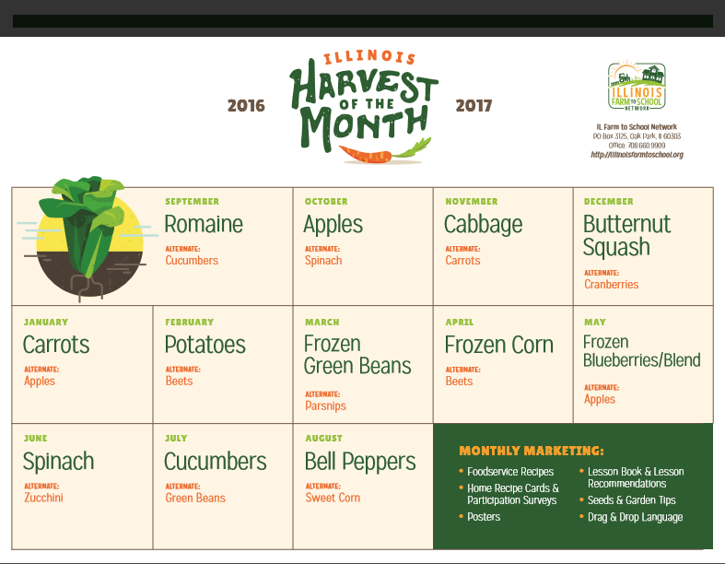
Notes:
Each year the Illinois Harvest of the Month calendar will be published for schools to download. The accompanying tools will be coordinated with each calendar. The current calendar can be viewed at: HarvestIllinois.org

Slide 11

What’s in store for 2017/18?
Illinois Harvest of the Month participation will be open to all districts in Illinois
IHOM School Stories, case studies of our pilot schools, will be available on our web page
Further development of regional food distribution channels
Notes:
Registration for the Harvest of the Month will be open to all Illinois schools in May of 2017. The 2017/2018 annual calendar, filled with monthly selections, will be available for viewing at that time.
Watch for best practices and stories of our pilot schools on our website in late summer of 2017.
Do you know a produce vendor or a distributor who sources locally or regionally? Drop us a line and share your find with us. We will invite them to connect with Illinois Harvest of the Month to supply monthly selections to schools in their area.

Slide 12

Reach out to the Illinois Farm to School Network for technical assistance
Lydia Mills
lydia@sevengenerationsahead.org
Diane Chapeta
diane@sevengenerationsahead.org
Notes:
Thank you for watching this instalment of the Illinois Farm to School Networks’ Mighty Mini Video series. If you have questions, please connect with us online at: http://illinoisfarmtoschool.org/
Have a local day!

