Slide 2
Adding Farm to School Programming One Apple at a Time
Notes:
Adding Farm to School Programming, One Apple at a Time! Room D244 Build a sustainable program that can connect to your site's existing efforts.
Add programming pieces that will build your farm to school know-how and capabilities. Learn how to create a program poised to grow with your community. Understand how to create sustainability through donations, community experts, and funding sources near and far.

Slide 3
Overview
Creating a cohesive plan
Adding program pieces
Building blocks to build more sustainability
Fund it!
Notes:
Adding Farm to School Programming, One Apple at a Time! Room D244 Build a sustainable program that can connect to your site's existing efforts.
Add programming pieces that will build your farm to school know-how and capabilities. Learn how to create a program poised to grow with your community. Understand how to create sustainability through donations, community experts, and funding sources near and far.

Slide 4
How do I develop a plan to grow Farm to School?
Create a vision and a plan
Register for programming! Become familiar with the Farm to School tools available
Build a team by connecting to others at your site including garden clubs, cooking staff, science and math educators, and Wellness teams
Create a one-two year plan to map out program pieces and growth

Slide 5
Resources for Planning
This comprehensive toolkit helps sites build a team, establish a vision, and develop a strategy for implementing and evaluating their farm to school programming.
Farm to School Planning Toolkit, USDA Office of Community Food Systems
We recommend building a strategy to measure the impact that your farm to school activities have on food producers, health, education, and the environment. This evaluation guide will give you common language, guidelines, and metrics to build and assess your local food sourcing and gardening efforts.
Evaluation for Transformation, National Farm to School Network
Vermont FEED (Food Education Every Day) developed a Farm to School Rubric, Action Planning Template, Impact & Feasibility Analysis Tool, and Media Kit to help farm to school teams create sustainable and beneficial programs.
Farm to School Planning Toolkit, VT FEED
This planning tool identifies ten pathways to follow as you plan for innovation and change in school food: food and health, wellness policy, teaching and learning, the dining experience, procurement, facilities, waste management, professional development, and marketing and communications.
Rethinking School Lunch, Center for Ecoliteracy

Slide 6
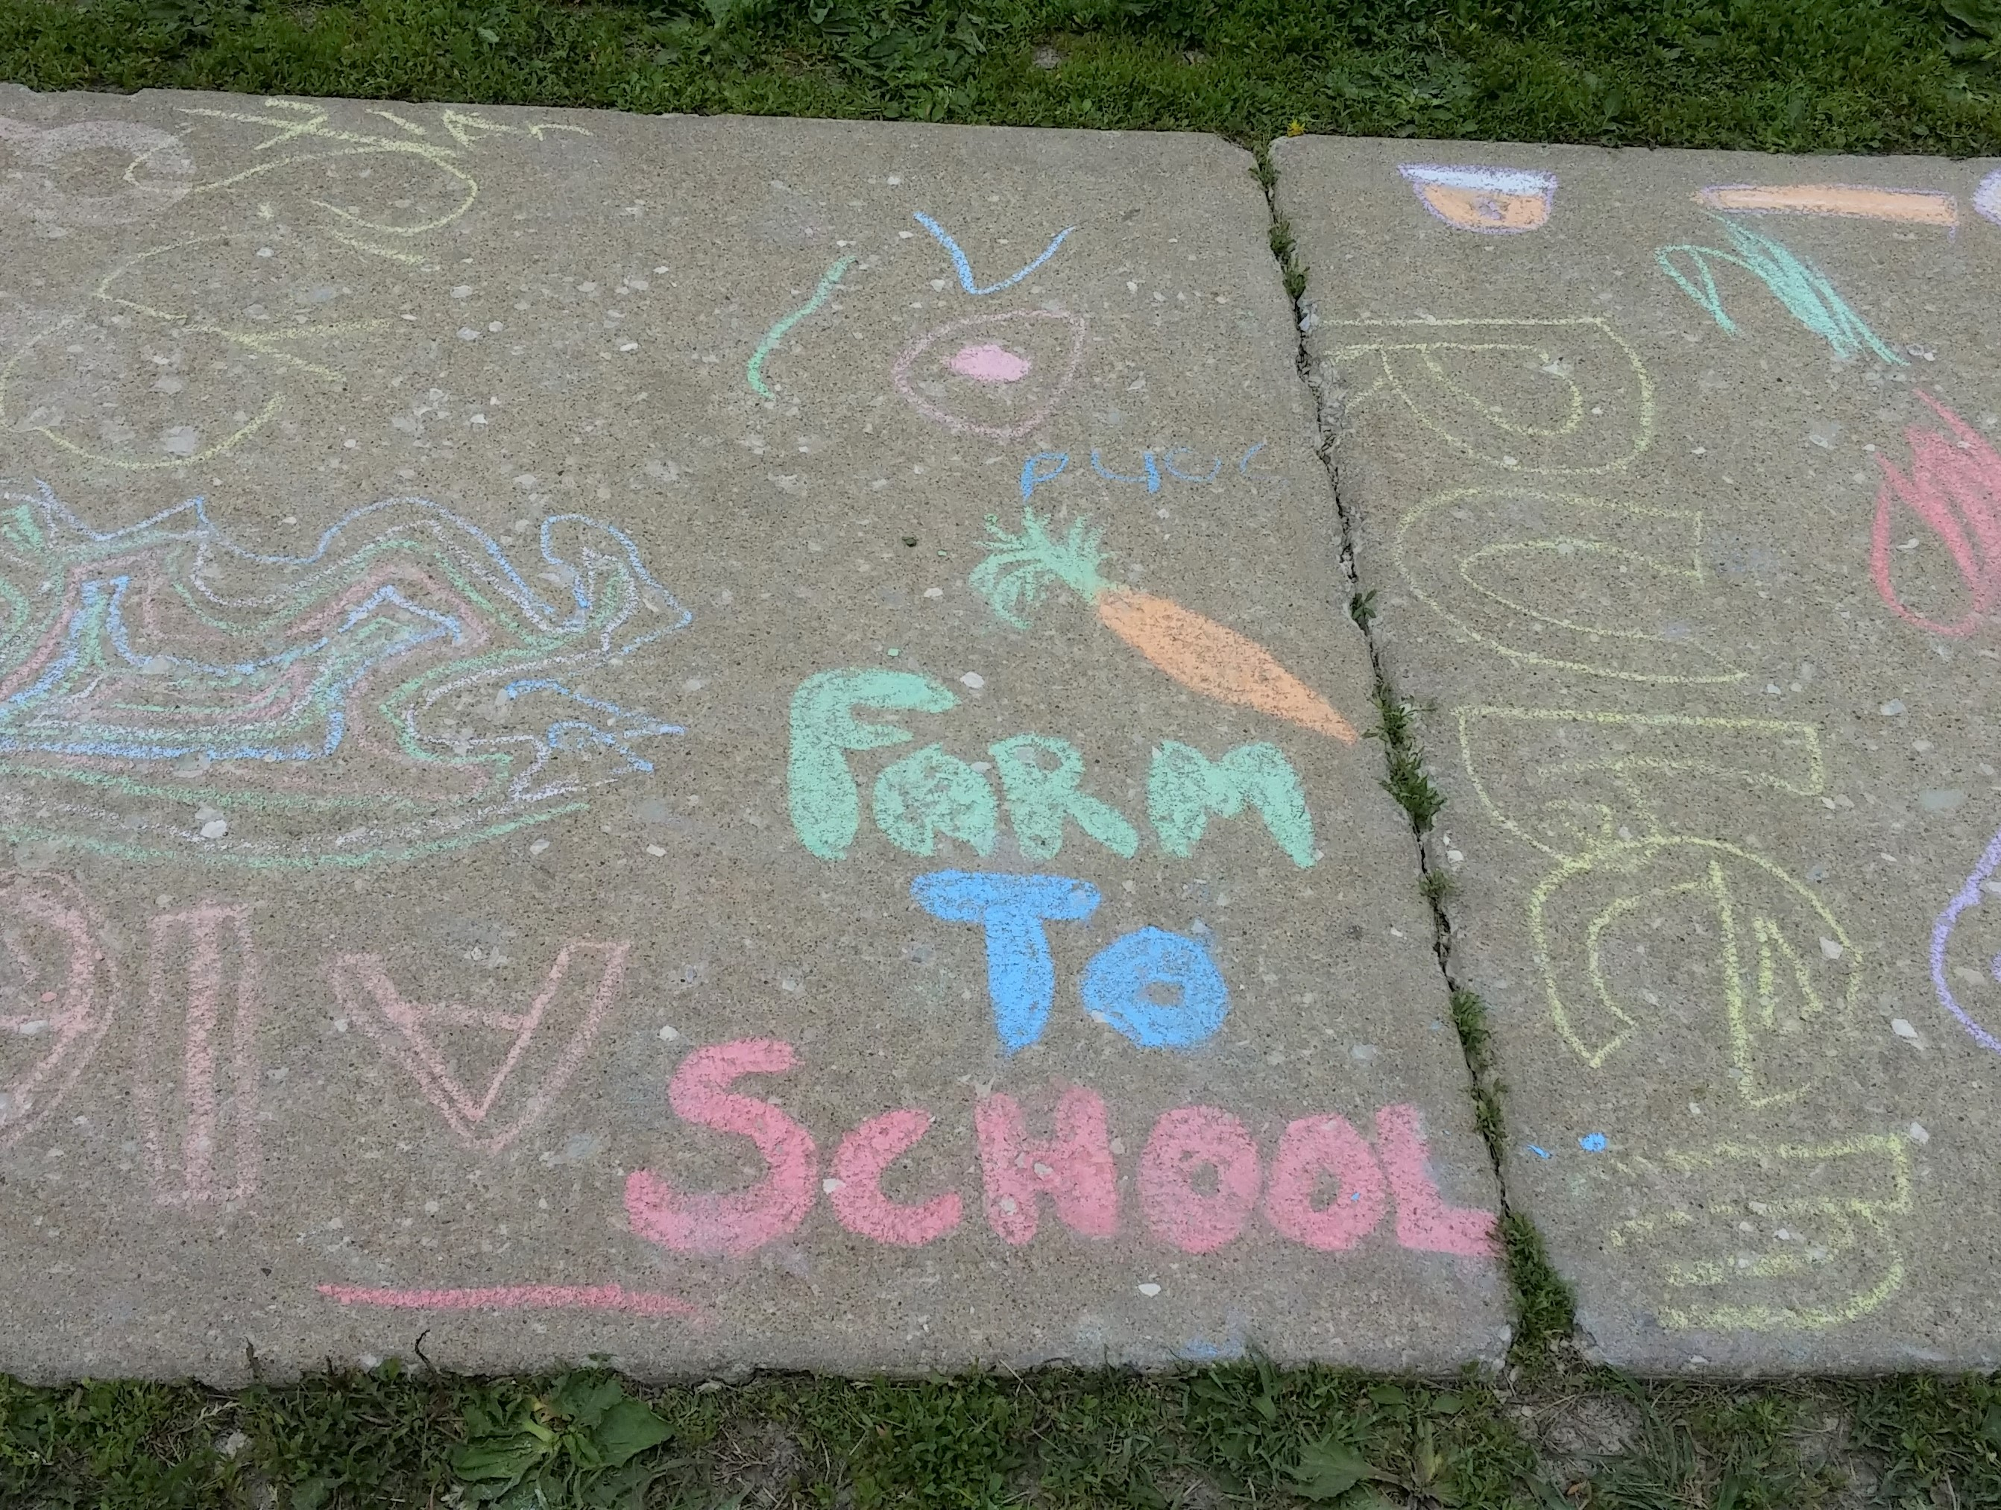
Combine local food with programming!

Slide 7
Start small!

Slide 8
Add Programming Slowly

Slide 9
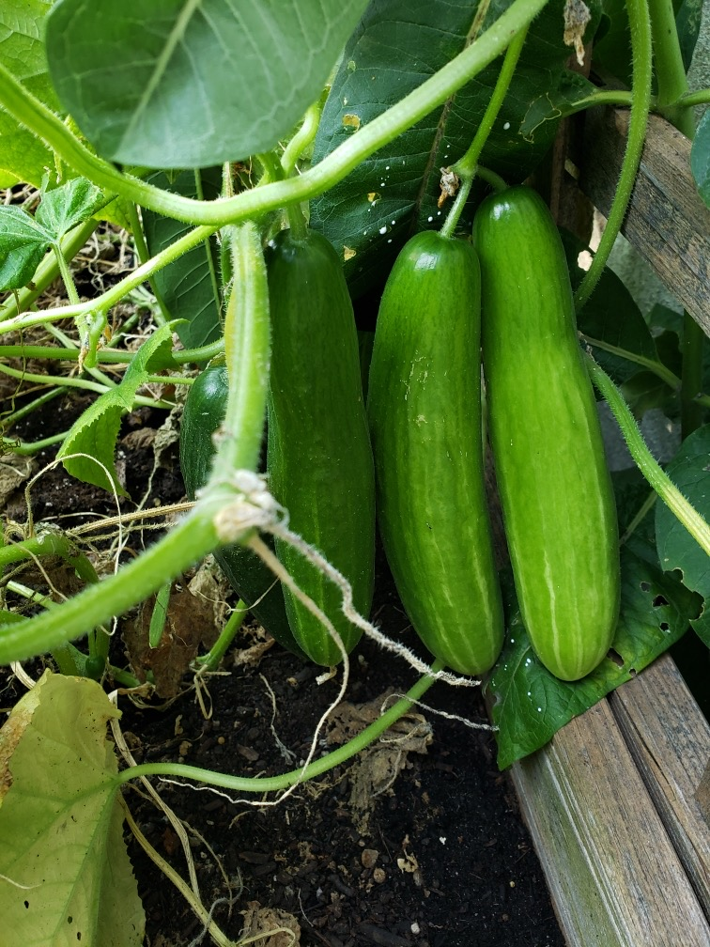
Connect Program Pieces
Farm to School programs connect to:
Garden Clubs and Indoor Garden Programs
Taste Tests
FFA Activities
Culinary Arts
Health Classes
Food Pantry/ Backpack Programs
Onsite Farmers Market
Wellness Teams

Slide 10
Improve Sustainability

Slide 11
Building Blocks for Sustainability
Programming
Connections
EXAMPLE: Taste Tests
Create a plan!
Build a team.
Begin programming by starting small.
Fund it and develop support!
Develop and adapt your vision.
Move forward!
Develop relationships to community resources.
Connect to existing programs to create a broader message and influence.
Fund it and continue building support.
Plan for future years.

Slide 12
Locate Funding
Supporting Farm to School with non-profit hospital community benefit dollars
http://www.farmtoschool.org/Resources/Hospital%20Community%20Benefit%20Dollars.pdf
Mighty Mini Video: Innovative Funding for Farm to School
http://illinoisfarmtoschool.org/video-training-series/innovative-funding-farm-school/
Illinois Farm to School Network Funding Toolkit
http://illinoisfarmtoschool.org/toolkit/funding/
Donations and grants from local businesses and companies!
https://efficientgov.com/blog/2017/11/10/5-big-box-store-community-grant-opportunities/
Apply for Grants- just do it!
http://illinoisfarmtoschool.org/toolkit/funding/

Slide 13
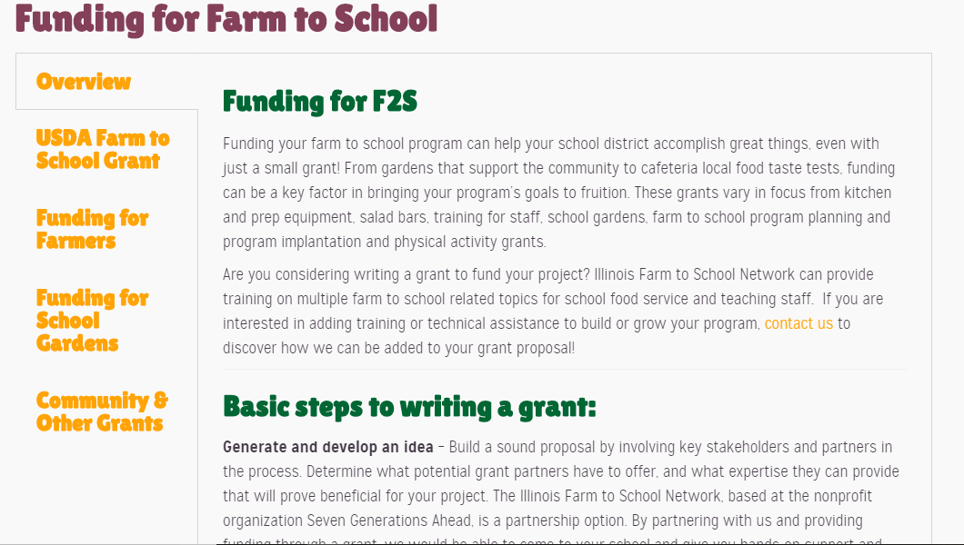
Sources for Grants and Funding

Slide 14
Mary Hosier I IL Farm to School Network Coordinator
mary@sevengenerationsahead.org

