Slide 2
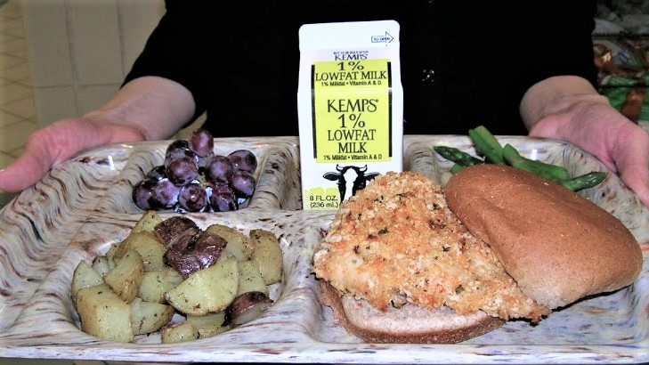
Menuing Local
Different Styles 4 Different Programs
Notes:
MenuingYour Local- DifferentStyles forDifferentPrograms Room D244
I found local asparagus...now what?
Buying locally is just the first step. Now you have to get it on the menu, add it to recipes or
tastings, and get kids to like it. Piece of cake! Right? Let us show you some basics of
menuing and incorporating local into your food program for K-12 and for early childhood
programs.

Slide 3
Overview
Ways to keep local affordable
Add local to recipes
as ingredients for a recipe bump
as a local entrée or meal
as a seasonal tasting menu
as the “local side” of salad bars
Create a local taste test
Menuing: different opportunities for different sites
Add local to special events, catering and celebrations

Slide 4
Keep Local Affordable
Create a balance on your menu- cost, frequency and pairing
Shop seasonally!
Shop seconds and imperfect
Add local in degrees
Grow your own!
Notes:
How to keep buying local affordable
Balance Menus: Place higher priced local items with cheaper priced menu items. ex: Local spinach pared with canned pears, raisins and a homemade vinaigrette dressing.
ex: Local grilled raspberry asparagus paired with mac and cheese.
Shop Seasonally: Buy when the local market is glutted with tomatoes, or zucchini, or greens.
Buy Seconds when available: Ask about seconds quality veg to process and freeze for winter soups, stews and entrees. You may be surprised that local farms have unsellable, oddly shaped or too large/small veggies at a cheaper price.
Add local in degrees: Swap out single ingredients for local ingredients. Set limits for local purchases based on budget.
Grow your own: cheapest local is right in your back yard!

Slide 5
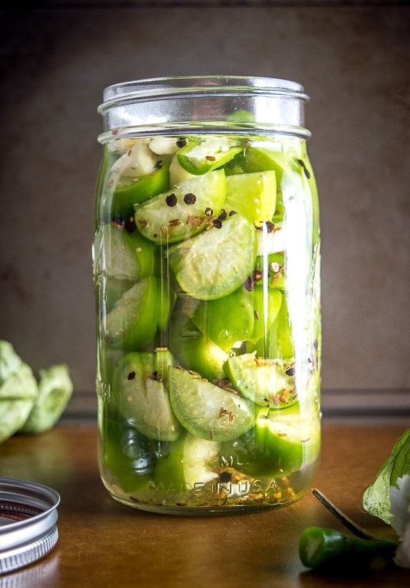
Adding to Recipes
Add local ingredients for a recipe bump!
Add local ingredients (flour, maple syrup, vegetables, fruits) that can be easily added in total, or swapped in part for standard ingredients.
Add local dairy to recipes such as milk, eggs, yogurt and cheese!
Create a local recipe with over 50% of the ingredients locally sourced using foods grown and produced in your region. Baked goods like muffins or quick biscuits, yogurt parfaits, sandwiches, pasta sauces, soups and casseroles are a great option.
Notes:
As ingredients for a recipe bump
As a local entrée or meal
As a seasonal tasting menu
As the “local side” of salad bars

Slide 6
Create a local meal
Add a local entrée or meal to your menu grid. Create a seasonal celebration around the meal and share local or state facts about the foods. (EXP: Illinois is the #1 producer of Pumpkin.)
Add a Harvest of the Month to the menu grid as a vegetable, entree, salad bar meal or side even in winter!

Slide 7
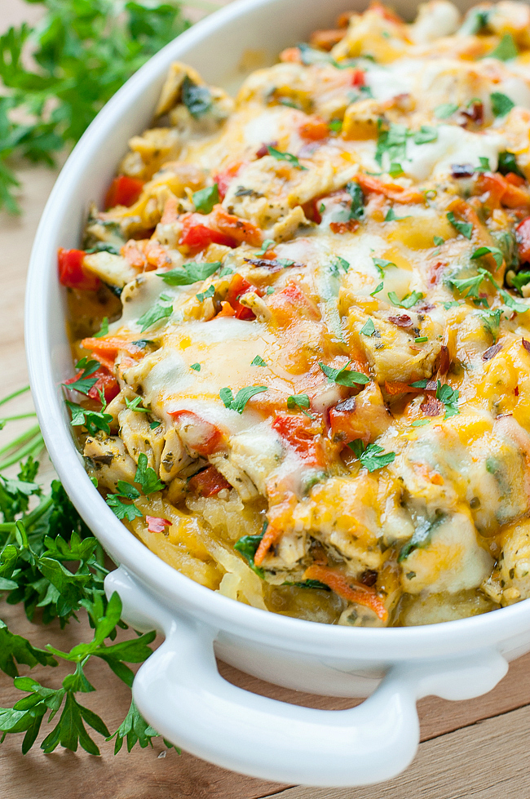
Create a tasting menu
Create menu sampling or tasting days to get impute from your kids and involve them in the development of local food recipes- or share a taste of local ingredients for a popular recipe local food bump
Local in side salads on the salad bar or on the line
Hot entrees with a local flair
New sides including veggie dishes, fruit recipes like compote or fruit salads, muffins and sauces, or a honey vinaigrette salad dressing.

Slide 8
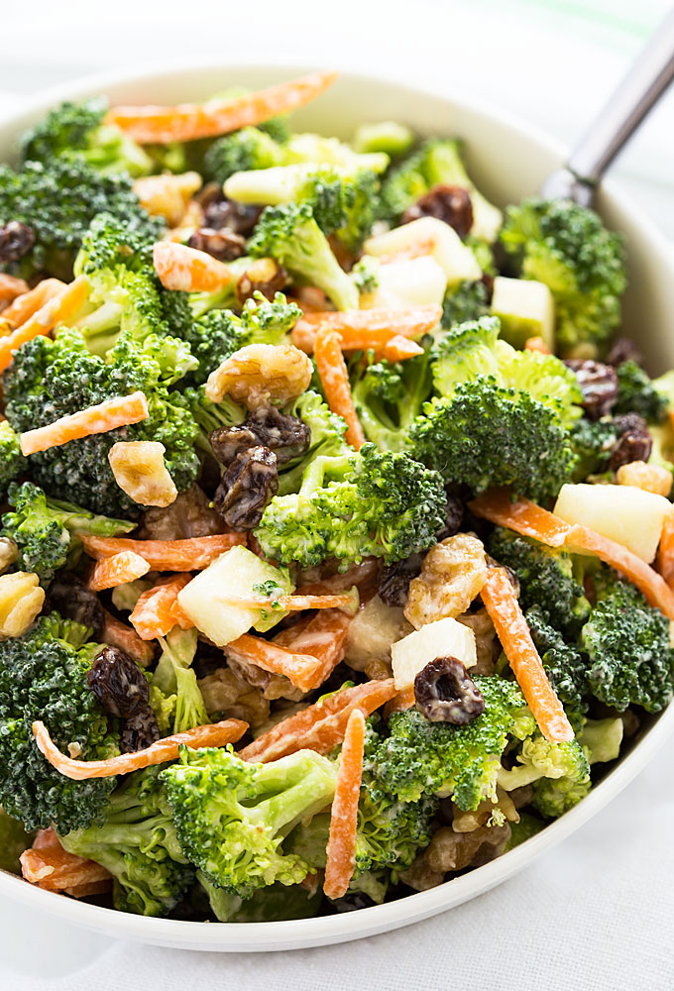
Make your salad bar local friendly!
Add local fruits, veggies and salads to your salad bar.
Add new salads with a seasonal flare! (pictured: Cool Summer Broccoli Salad in August)
Add assorted hand-held fruits while in season
Add local grain in salads
Feature different varieties of local apples in October!

Slide 9
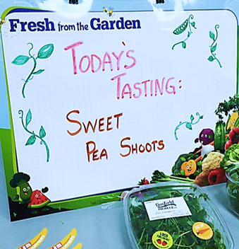
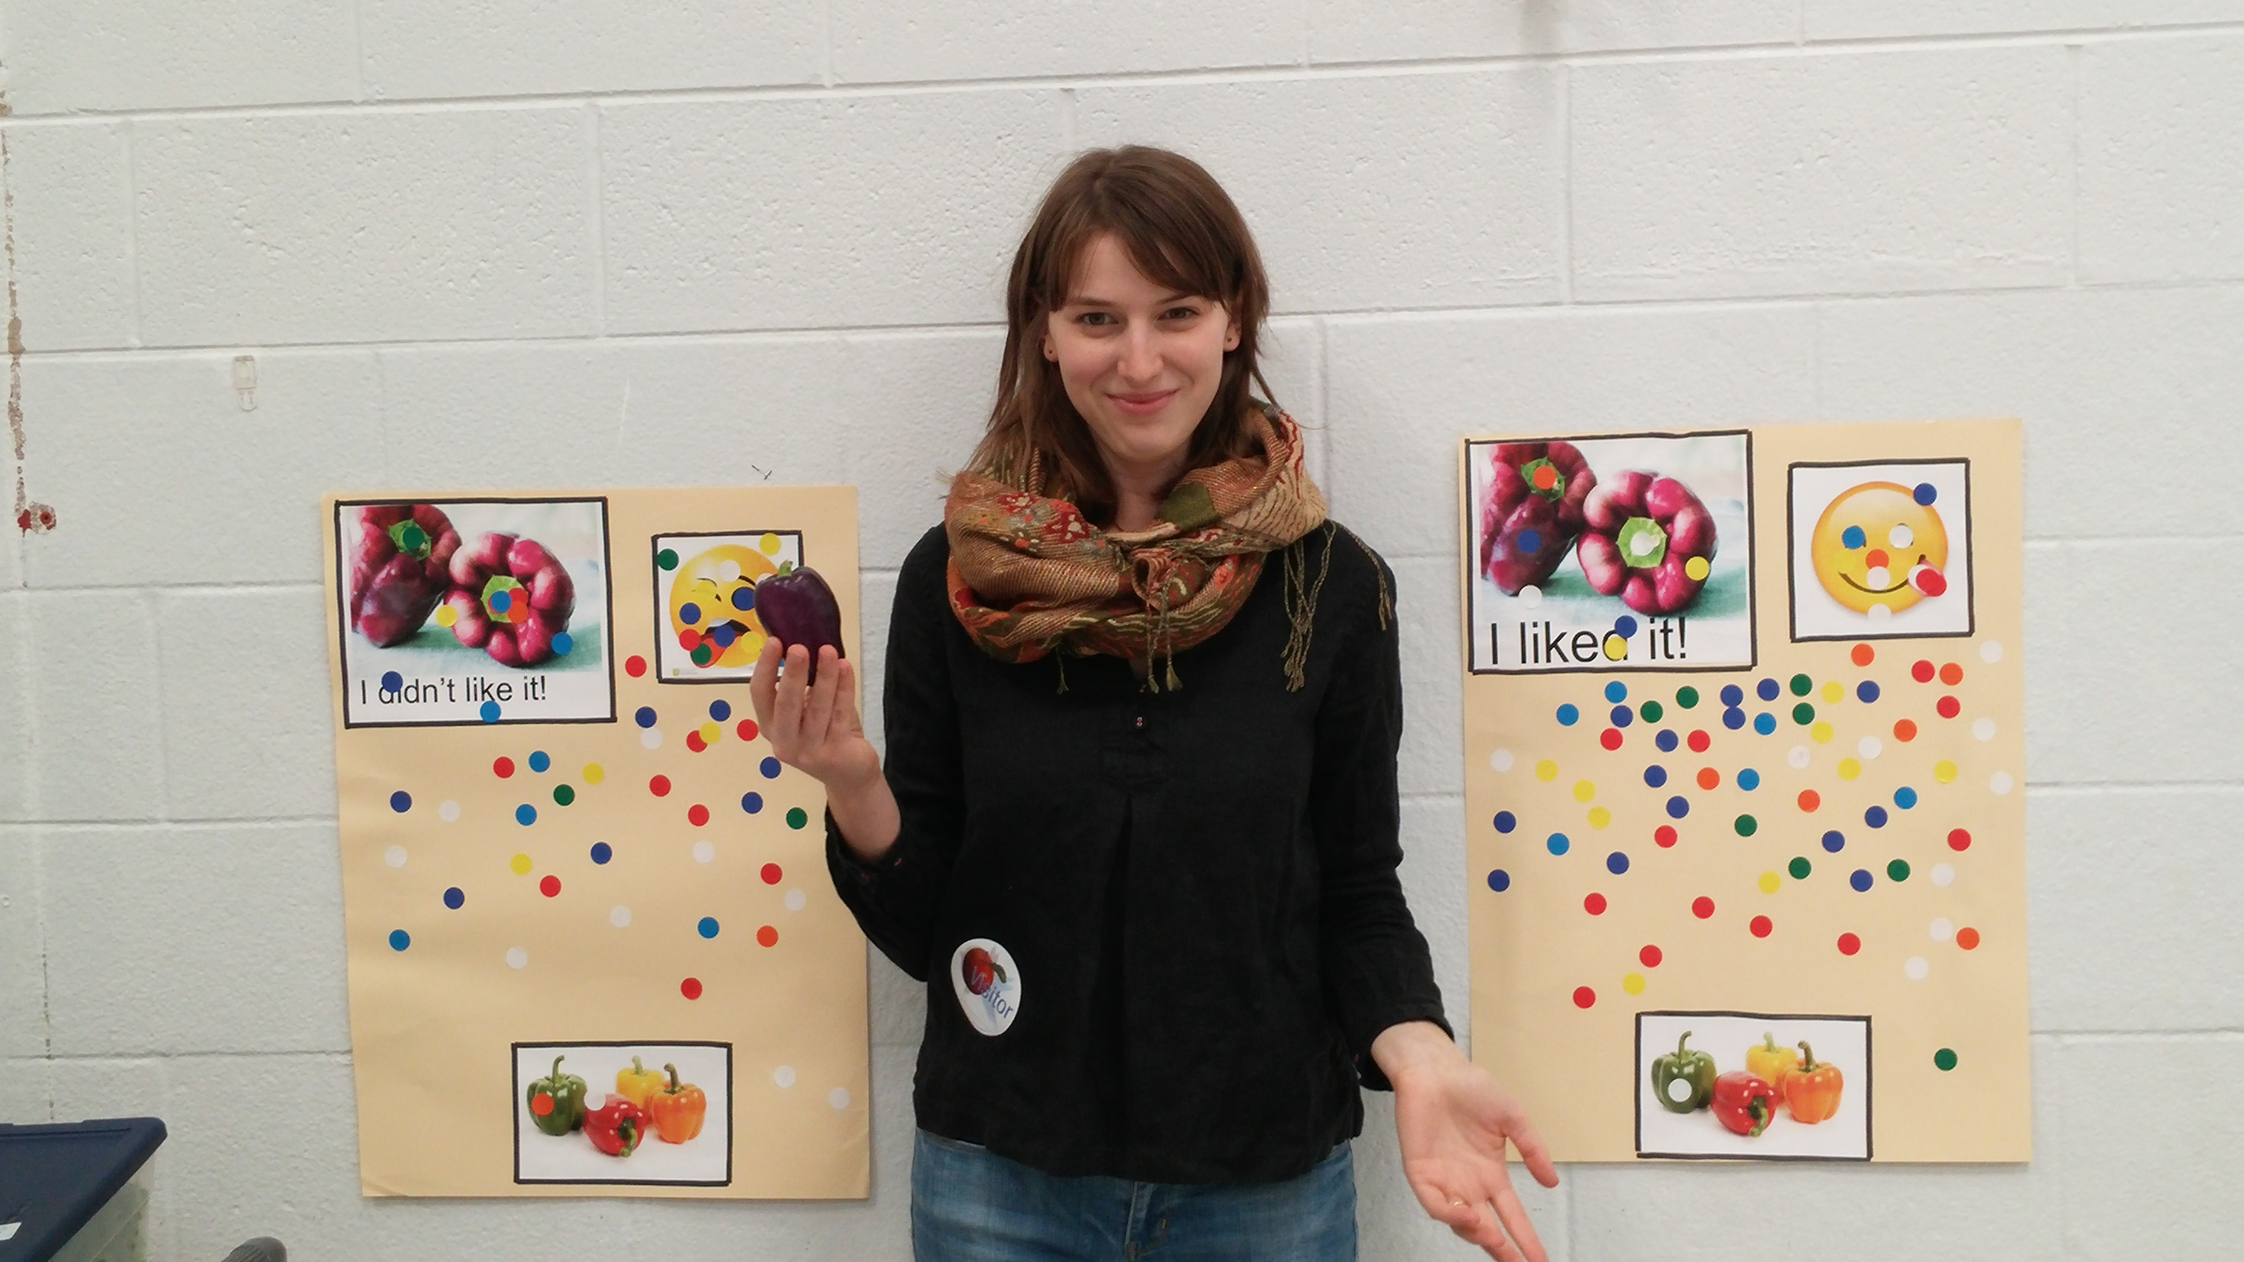
Taste tests
Create taste test days and tie them to a school garden, a culinary program or Ag classes
Add local food information and tastings to a school event or fair
Add a local food tasting to a school celebration
Add local foods education and tasting to Back to School registration days
Develop a relationship with a local farm and create a space for a CSA pick-up
Host a mini Farmers Market at school
Promote a local foods fundraiser

Slide 10
Give ‘em a taste!
https://drive.google.com/file/d/1Wl8Cmal3AF-i6FNa7WSMpyXa001Cn-0u/view

Slide 11
Create an action plan to incorporate local foods
What type of menu do you currently use?
Does your menu change throughout the year or repeat on a cycle?
Are there items already served through your meals that you can simply substitute with local items? Which items are they, and at what time of the year are they available?
How would your menus need to change to incorporate more local foods into your childcare meals?
Would you develop or use recipes that you’ve never used before in order to incorporate more local ingredients into the meals and snacks you serve?
How would you promote taste tests and local menu items to children, staff, and parents?

Slide 12
Put it on the menu
COLD
Got a salad bar? Expand your existing salad bar choices to include local fruits, legumes and veggies
Incorporate composed salads in meals as a vegetable, fruit or as a full entrée option for a Meatless Monday
Grades 6-12 add local options to ala cart selections like salads, fruit & yogurt cups, sandwiches and veggie packs
Feature a local fruit or veggie as a Harvest of the Month
Incorporate local foods into existing breakfast entrees and menu favorites
HOT
Feature a seasonal, local menu day on multiple dates during the year
Focus on local foods during National School Lunch Week, or Farm to School Month in October
Add local foods like cheese, onions, cilantro or lettuce to existing entrees as toppers and condiments
Incorporate local ingredients into quick scratch or basic scratch recipes
Design and promote a local entrée or side with town names like Lemont Lasagna or Verona Veggie Quesadillas

Slide 13
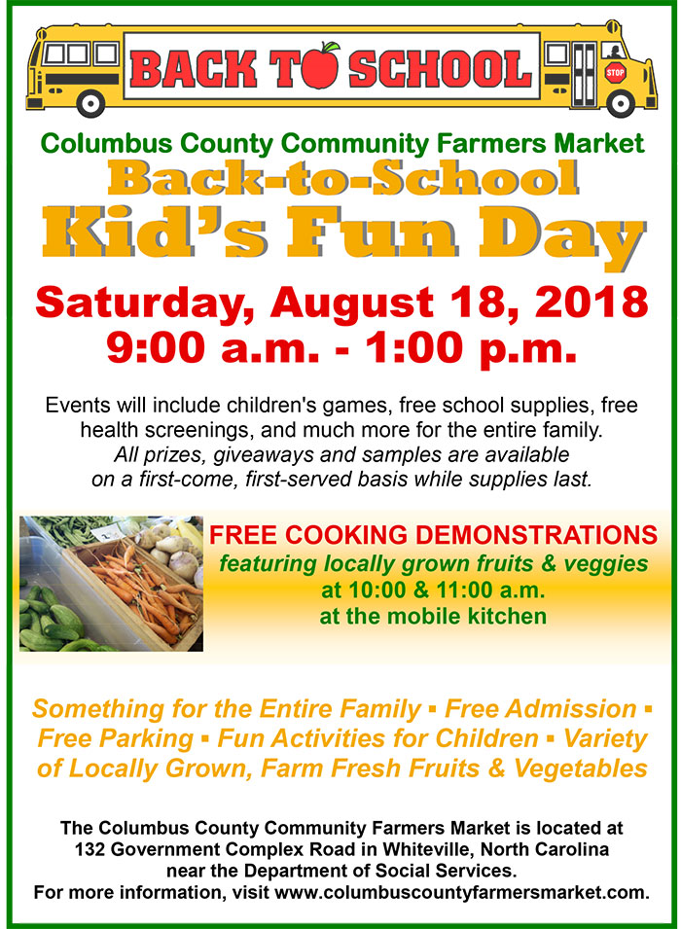
Celebrations!
Incorporate local choices in foods for special events like sports concessions, spirit week, plays and concerts or any catered event.
Create events focused on local foods like seed swaps, plant sales, mini farmers market for families, Back-to-School, Wellness Day, Garden season kickoff and other events that are a natural fit.

Slide 14
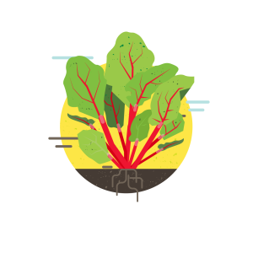
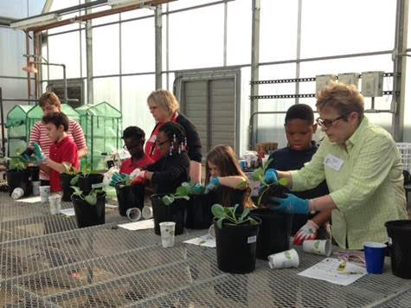
Remember! Garden food is local food.
Gardens have intrinsic value for children and adults
Other benefits:
Increase fruit and vegetable consumption
Teach children about healthy eating habits
Connect them to their natural environment
Develop physical and social skills
Reinforce educational concepts

Slide 15
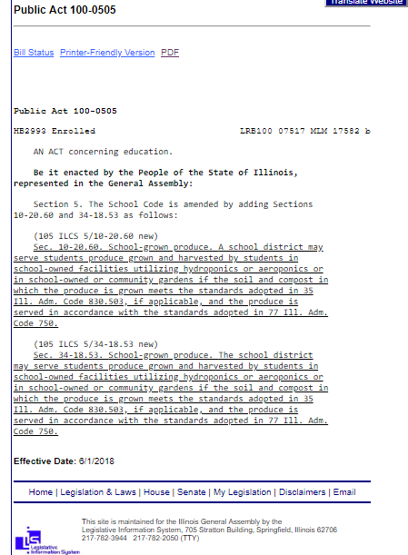
IL garden produce is an allowable food source for NSLP and CACFP! NSLP SFA’s can utilize funds for hard costs in the garden!

Slide 16
Mary Hosier I IL Farm to School Network Coordinator
mary@sevengenerationsahead.org

