Slide 2
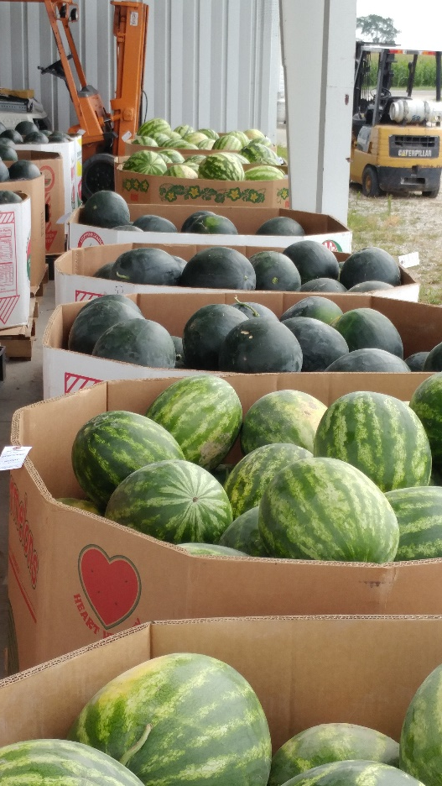
Farm to School 101
Connecting the Dots

Slide 3
Overview
Farm to School Review
Programs
Great Apple Crunch
IL Harvest of the Month
Learning Gardens
Sharing with Schools, Boarding Sites, Summer Programs & Early Childcare Providers
Looking for Community Partners & Support
Notes:
Learn the basics of Farm to School. Next, learn to connect your Farm to School efforts to culinary arts, FFA programs, indoor and outdoor garden programs, cafeteria and meal programs, area grocery stores, food pantries and many more health-centric organizations in your community to create a cohesive program that builds lifelong, good eating habits and promotes community connections.

Slide 4
Farm to School’s Core Components
Strengthening the connections that communities have with fresh, healthy food and local producers
Procurement
Local food in taste tests, snacks, and school meals
Education
Learning about agriculture, food, health, & nutrition
School Gardens
Hands-on engagement

Slide 5
Illinois Farm to School Network
Managed by Seven Generations Ahead
Non-profit promoting the development of ecologically sustainable and healthy communities around the region
IL Core Partner, National Farm to School Network
Information, advocacy and networking hub for communities working to bring local food sourcing, school gardens and food and agriculture education into schools and early care and education settings across the country.

Slide 6
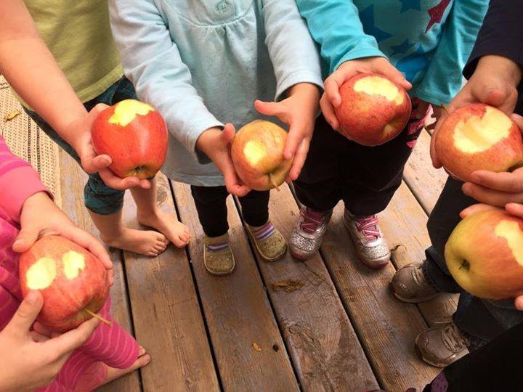
Illinois Farm to School Network
Over 1200 IL Farm to School Network Members!
Teachers
Early care providers
Foodservice staff
Farmers
Students
Public health promoters

Slide 7
Network Support & Resources
illinoisfarmtoschool.org/
harvestillinois.org
Monthly newsletter
In-person trainings
One-on-one consulting

Slide 8
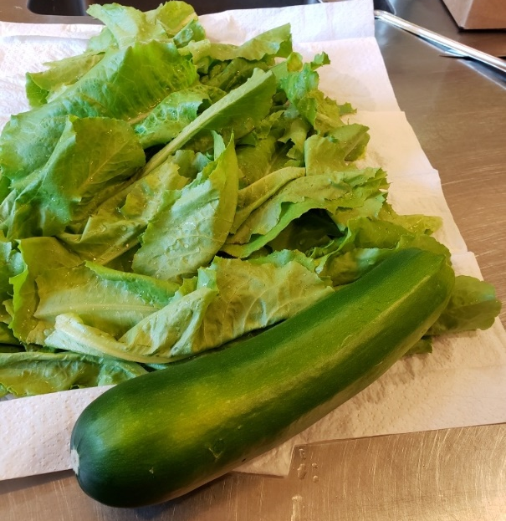
Key IL Farm to School Programs
Illinois Great Apple Crunch
Illinois Harvest of the Month
Learning Gardens

Slide 9
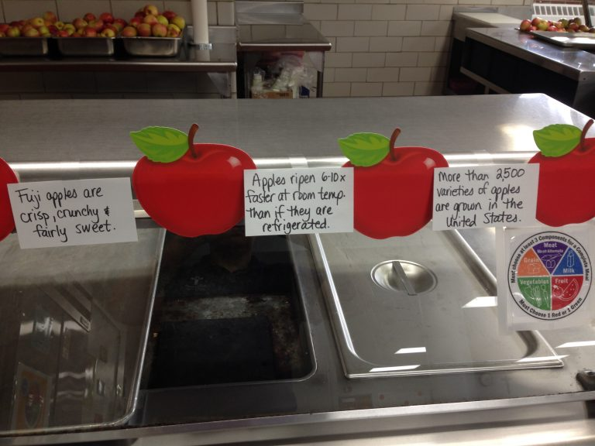
The Great Lakes Great Apple Crunch!

Slide 10
Connections and Tools
Tools to create a fantastic Crunch!
Connections to Harvest of the Month and Gardens!
Social media and promotions

Slide 11
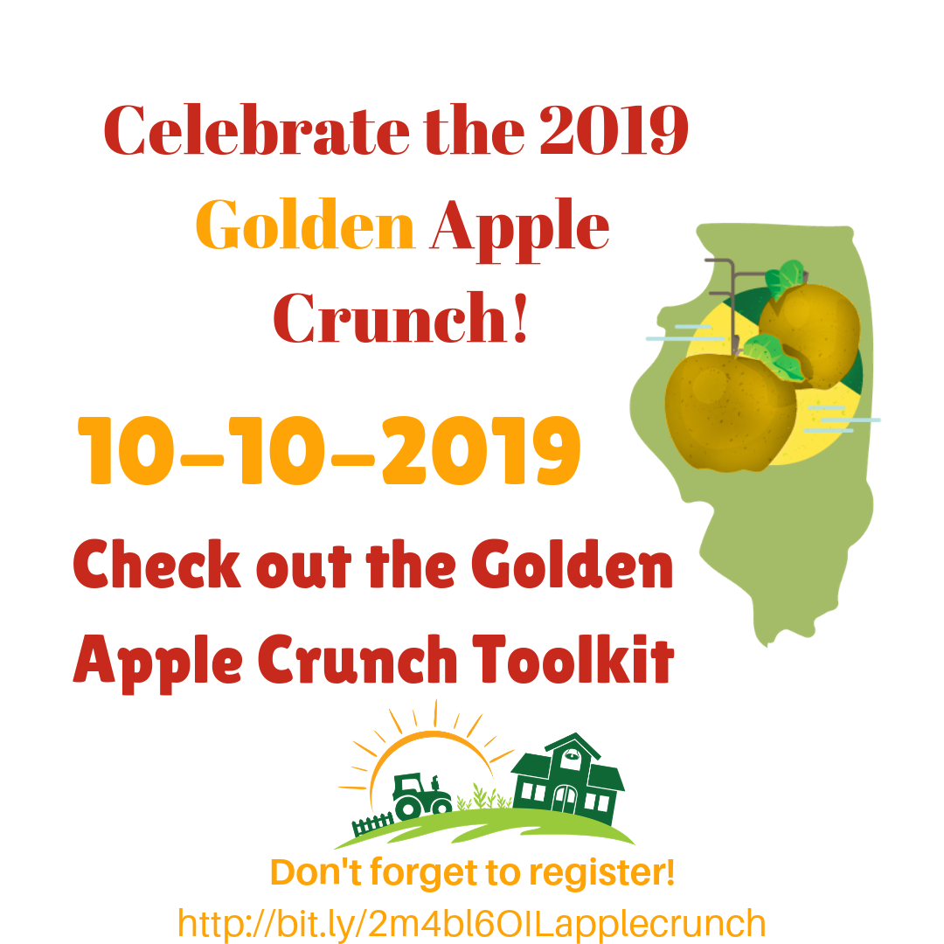
A great first-step to celebrate local food!
One-day fun event on the second Thursday in October
Participants Crunch into local apples!
Website: illinoisfarmtoschool.org/great-apple-crunch/
Local orchard locator, toolbox and the Crunch Guide
Register online after May 15th
Share your pictures, activities and the fun on social media and on our website!

Slide 12
For summer feeding & ECE too!

Slide 13
IL Harvest of the Month
Participants feature local or garden foods every month
Teaches kids about seasonal eating and develops student acceptance of fresh, healthy foods
Makes it easy for sites to bring food education into the meal program, the garden and the classroom
Provides ways to incorporate wellness work into feeding programs
Teaches program staff how to buy and celebrate local food

Slide 14
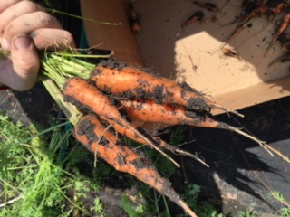
Site Gardens

Slide 15
Garden Connections
School gardens have intrinsic value for the students and teachers who are able to use them. However, there are other benefits to bringing a working, edible garden into the daily life of a school. These benefits have been tested and documented, and range from increased fruit and vegetable consumption (and potential for childhood obesity reduction) to increased test scores and better learning in STEM classes.
Utilize online K-12 curriculum! Check out the toolkit: http://illinoisfarmtoschool.org/toolkit/nutrition-education/
Don’t forget early Pre-K! Gardening in early care settings provides hands-on experiential learning for children that help your program meet the Illinois Early Learning and Development Standards. It increases opportunities for development of physical and social skills while also teaching healthy eating habits.
STEAM activities for ECE: http://illinoisfarmtoschool.org/toolkit/farm-early-care/
Connect Harvest of the Month to school activities or community garden program
Use garden produce for tastings in the cafeteria
Use garden produce as a part of lessons in the classroom
Connect your school garden to the school lunch menu and promote the veggies your students have grown
Connect your school garden to a mini fall Farmers Market at school
Share excess garden produce with a local food pantry as part of a HS community support requirement

Slide 16
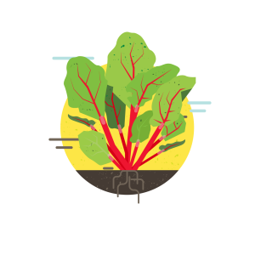
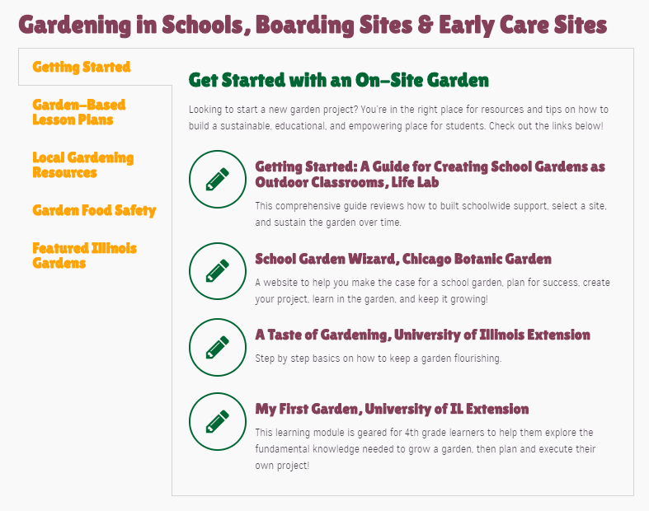
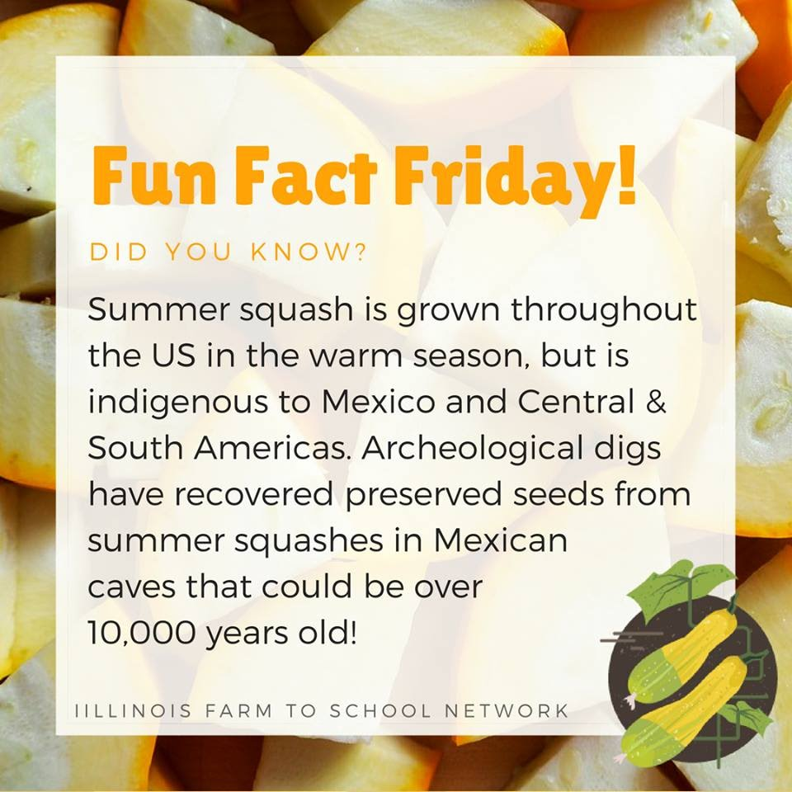
IFSN Garden Toolkit

Slide 17
How do I share Farm to School?
Look for potential participants like K-12’s, early childcare providers, summer programs including camps, feeding & garden sites in your community
Share information about the concept of Farm to School and programming, including gardening
Invite them to check out the website and contact us for further information and assistance!

Slide 18
Support comes in many forms
Financial and TEAM supporters
Grant funds earmarked for community health
Community leaders in health
Like-minded community organizations
Community Initiatives
Parent Groups
Other sites similar to yours!
In-Kind Supporters
Supplies for gardens
Supplies for events and tastings
Expert Advice and Trainers
Educators

Slide 19
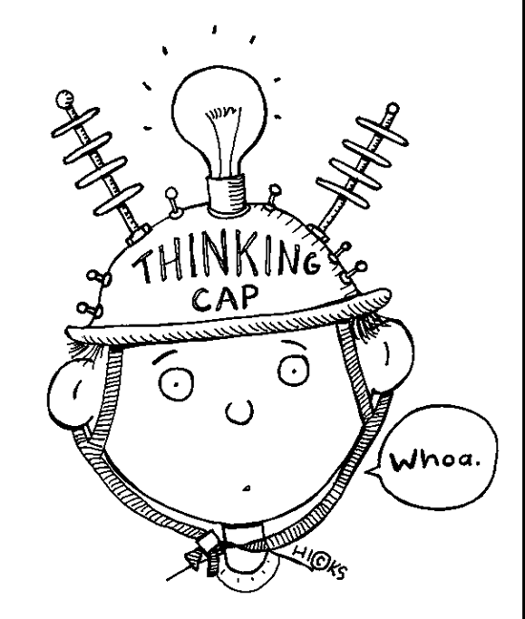
Connecting the dots to locate partners and support is as simple as comparing your program to community efforts and existing programs at your site!

Slide 20
Partnerships bring opportunities
University Extension Master Gardeners and SNAP Educators
Area Health Organizations
Community Gardens
Farmers Market
Medical Centers and Not-for-Profit Hospitals
Local Producers!
Learning Farms
County Government
Remember!
Partners bring expertise and a specialized skill set, access to a bigger audience, venues for activities and events, educational opportunities, extra support and often funding or in-kind support to your program!
Don’t be a solo act.
Invite your community to the table!

Slide 21
Mary Hosier I IL Farm to School Network Coordinator
mary@sevengenerationsahead.org

