Slide 1
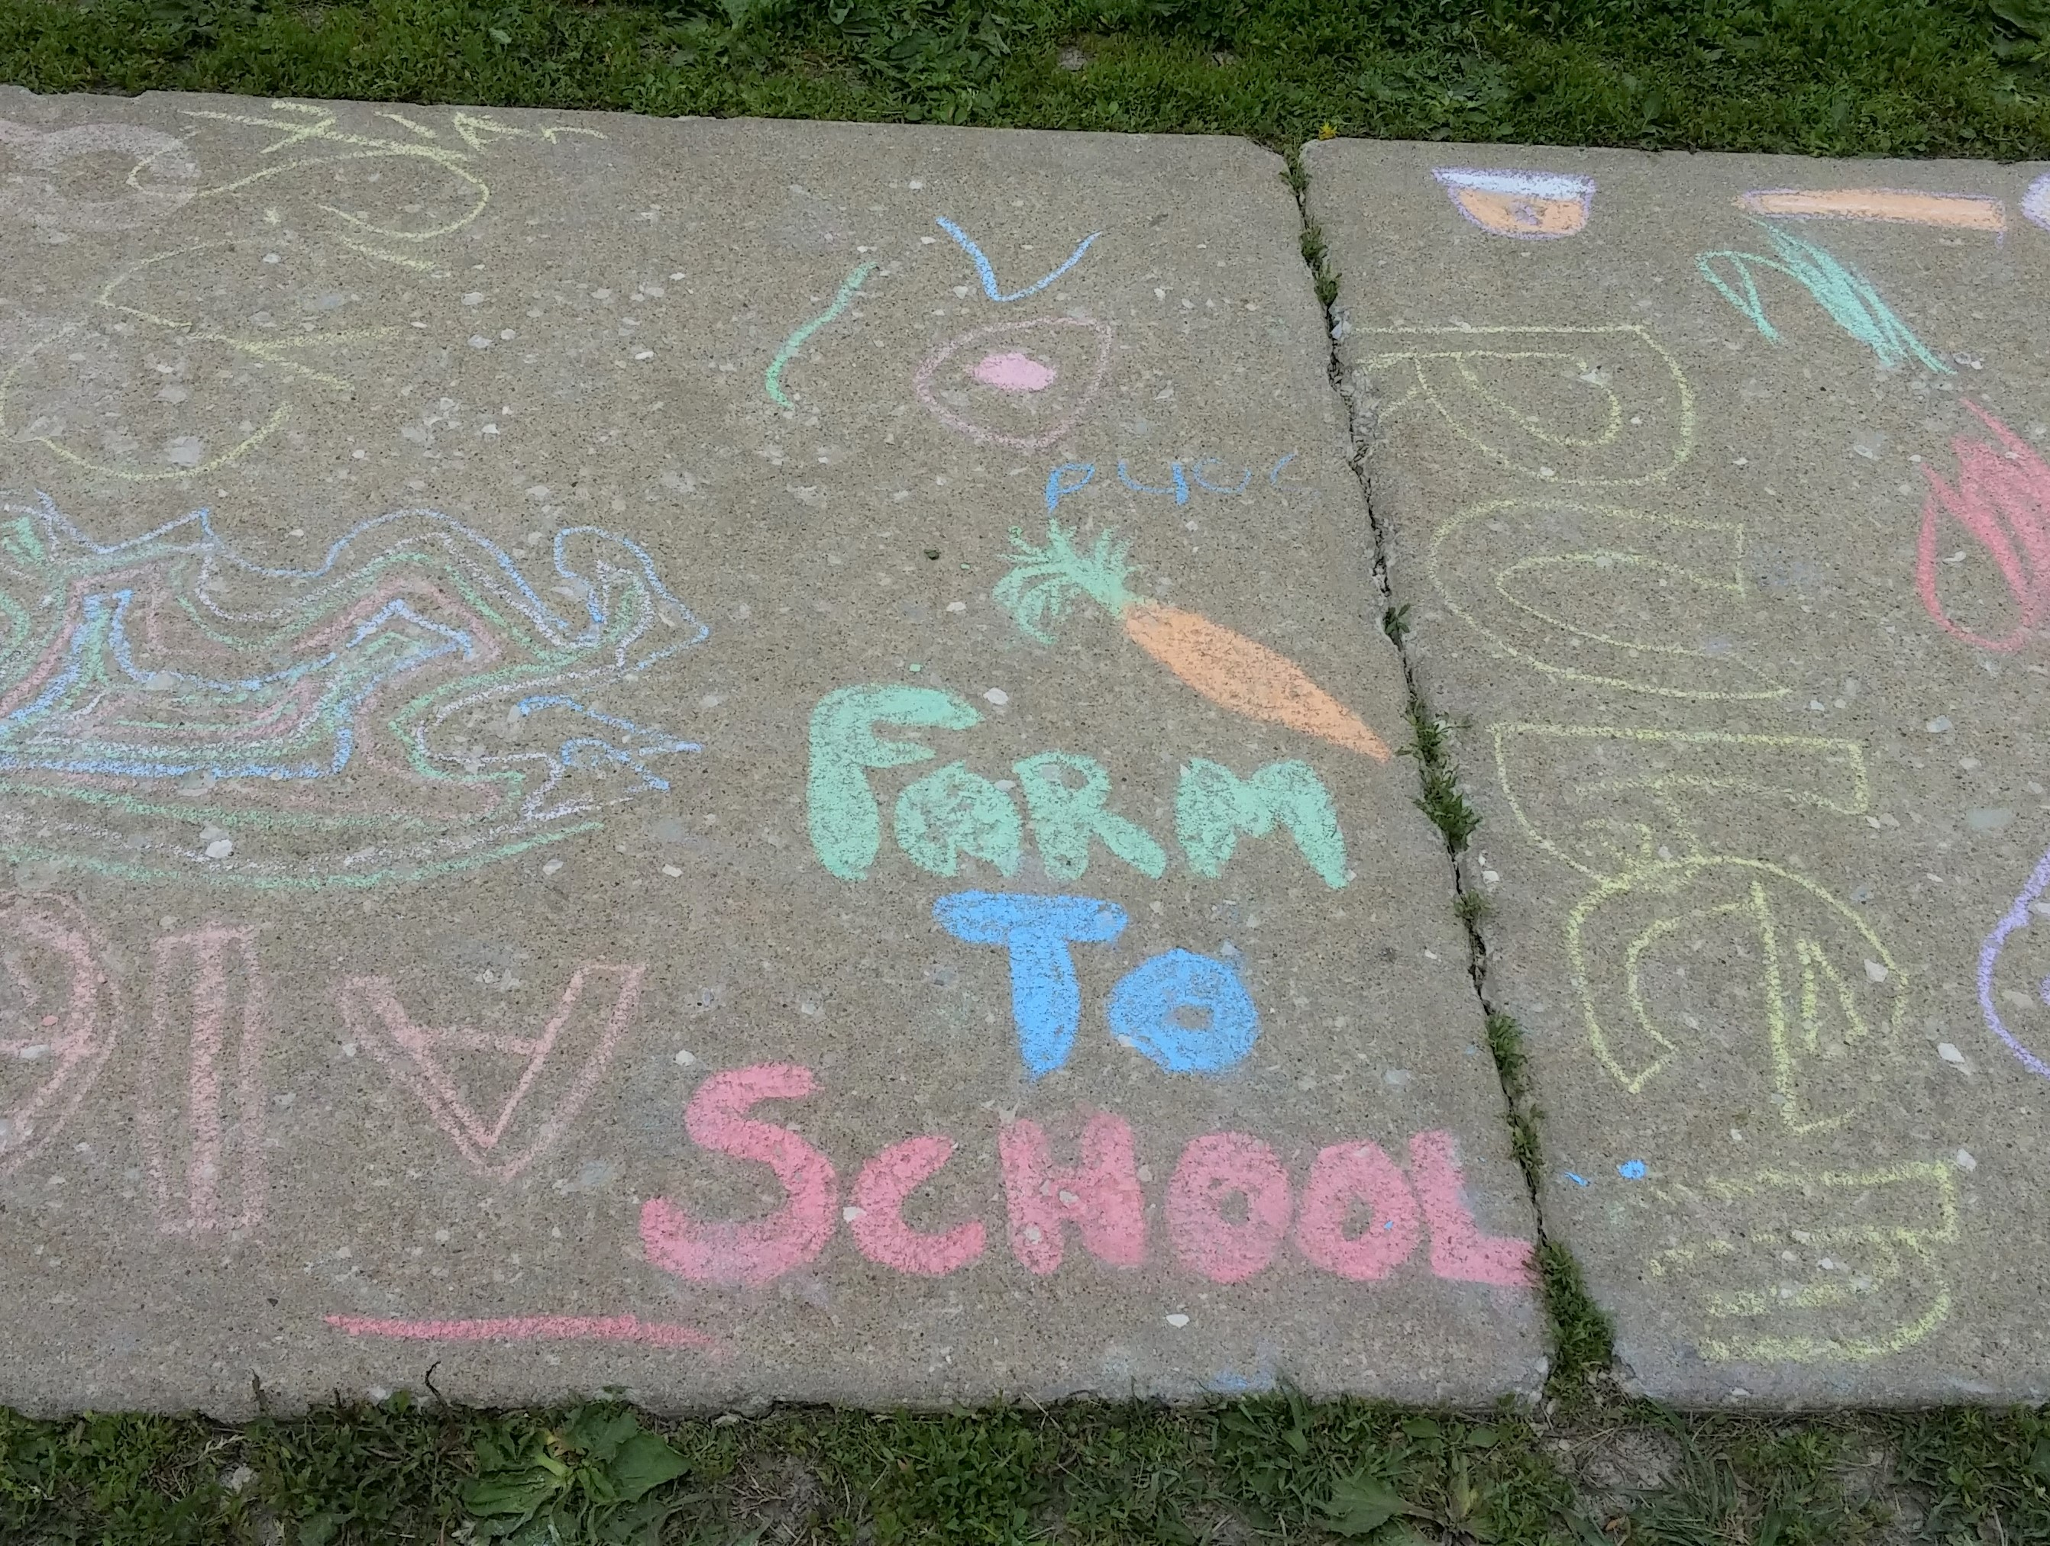
Local Procurement and Farm to School Programming

Slide 2
Step One
Understand local food..
Know what’s growing so you can focus on fresh, local procurement.
Understand there’s more to local, beyond fruit and veggies.
Local yogurt and string cheese
Local flour and grains like rice
Local proteins
Local honey and maple syrup
Understanding seasonal availability is your first step to successfully purchasing local foods.
Discover the seasons for local at: IL Farmers Market Assoc What’s in Season?
Contact your local farmers market manager for grower info and seasonal info for your area.
Search on IL Market Maker to discover what’s available in your area.
Look on the ISBE LFS list for interested growers and producers.
“.. a school called inquiring about what veggies I could deliver for next month’s menu. In late November..”
*shared at the Everything Local farmer conference

Slide 3
Step Two Discover ways to menu Illinois foods year-round
IL Farm to School Network Toolkit
Illinoisfarmtoschool.org
IFSN Mighty Mini Training Videos
Adding Local to the Menu
Chef Ann Recipes and Menuing
Toolbox
Use food resource toolkits! Register for IL Harvest of the Month

Slide 4
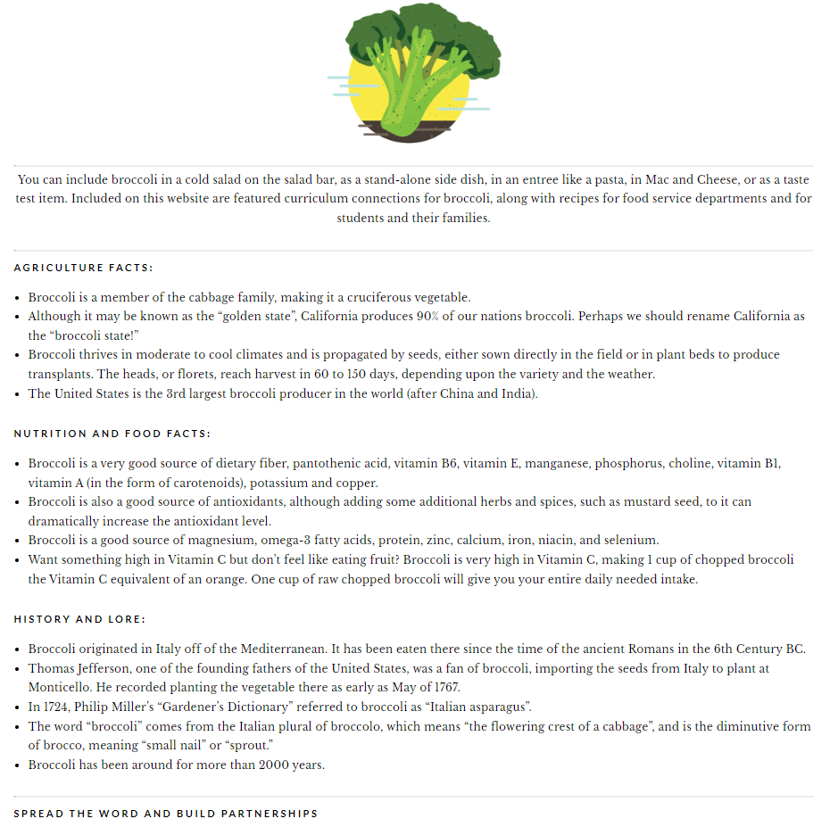
Step Three
Utilize the resources available to you
IL Harvest of the Month food-based education, fun activities and recipes for 38 foods.
Register for IL Harvest of the Month

Slide 5
Step Four: Procurement
Start by making a plan.

Slide 6
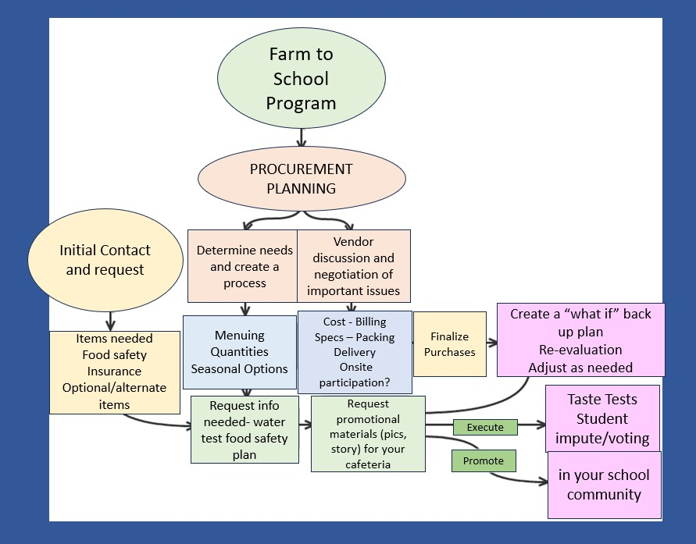
Develop a Plan That Works

Slide 7
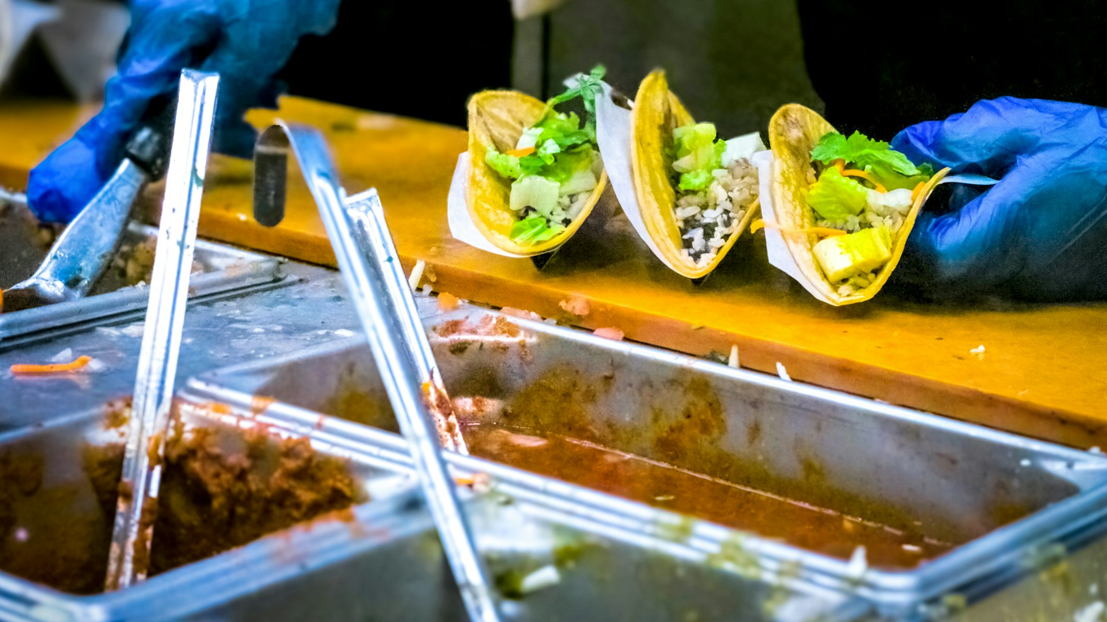
Create A Buyer Profile

Slide 8
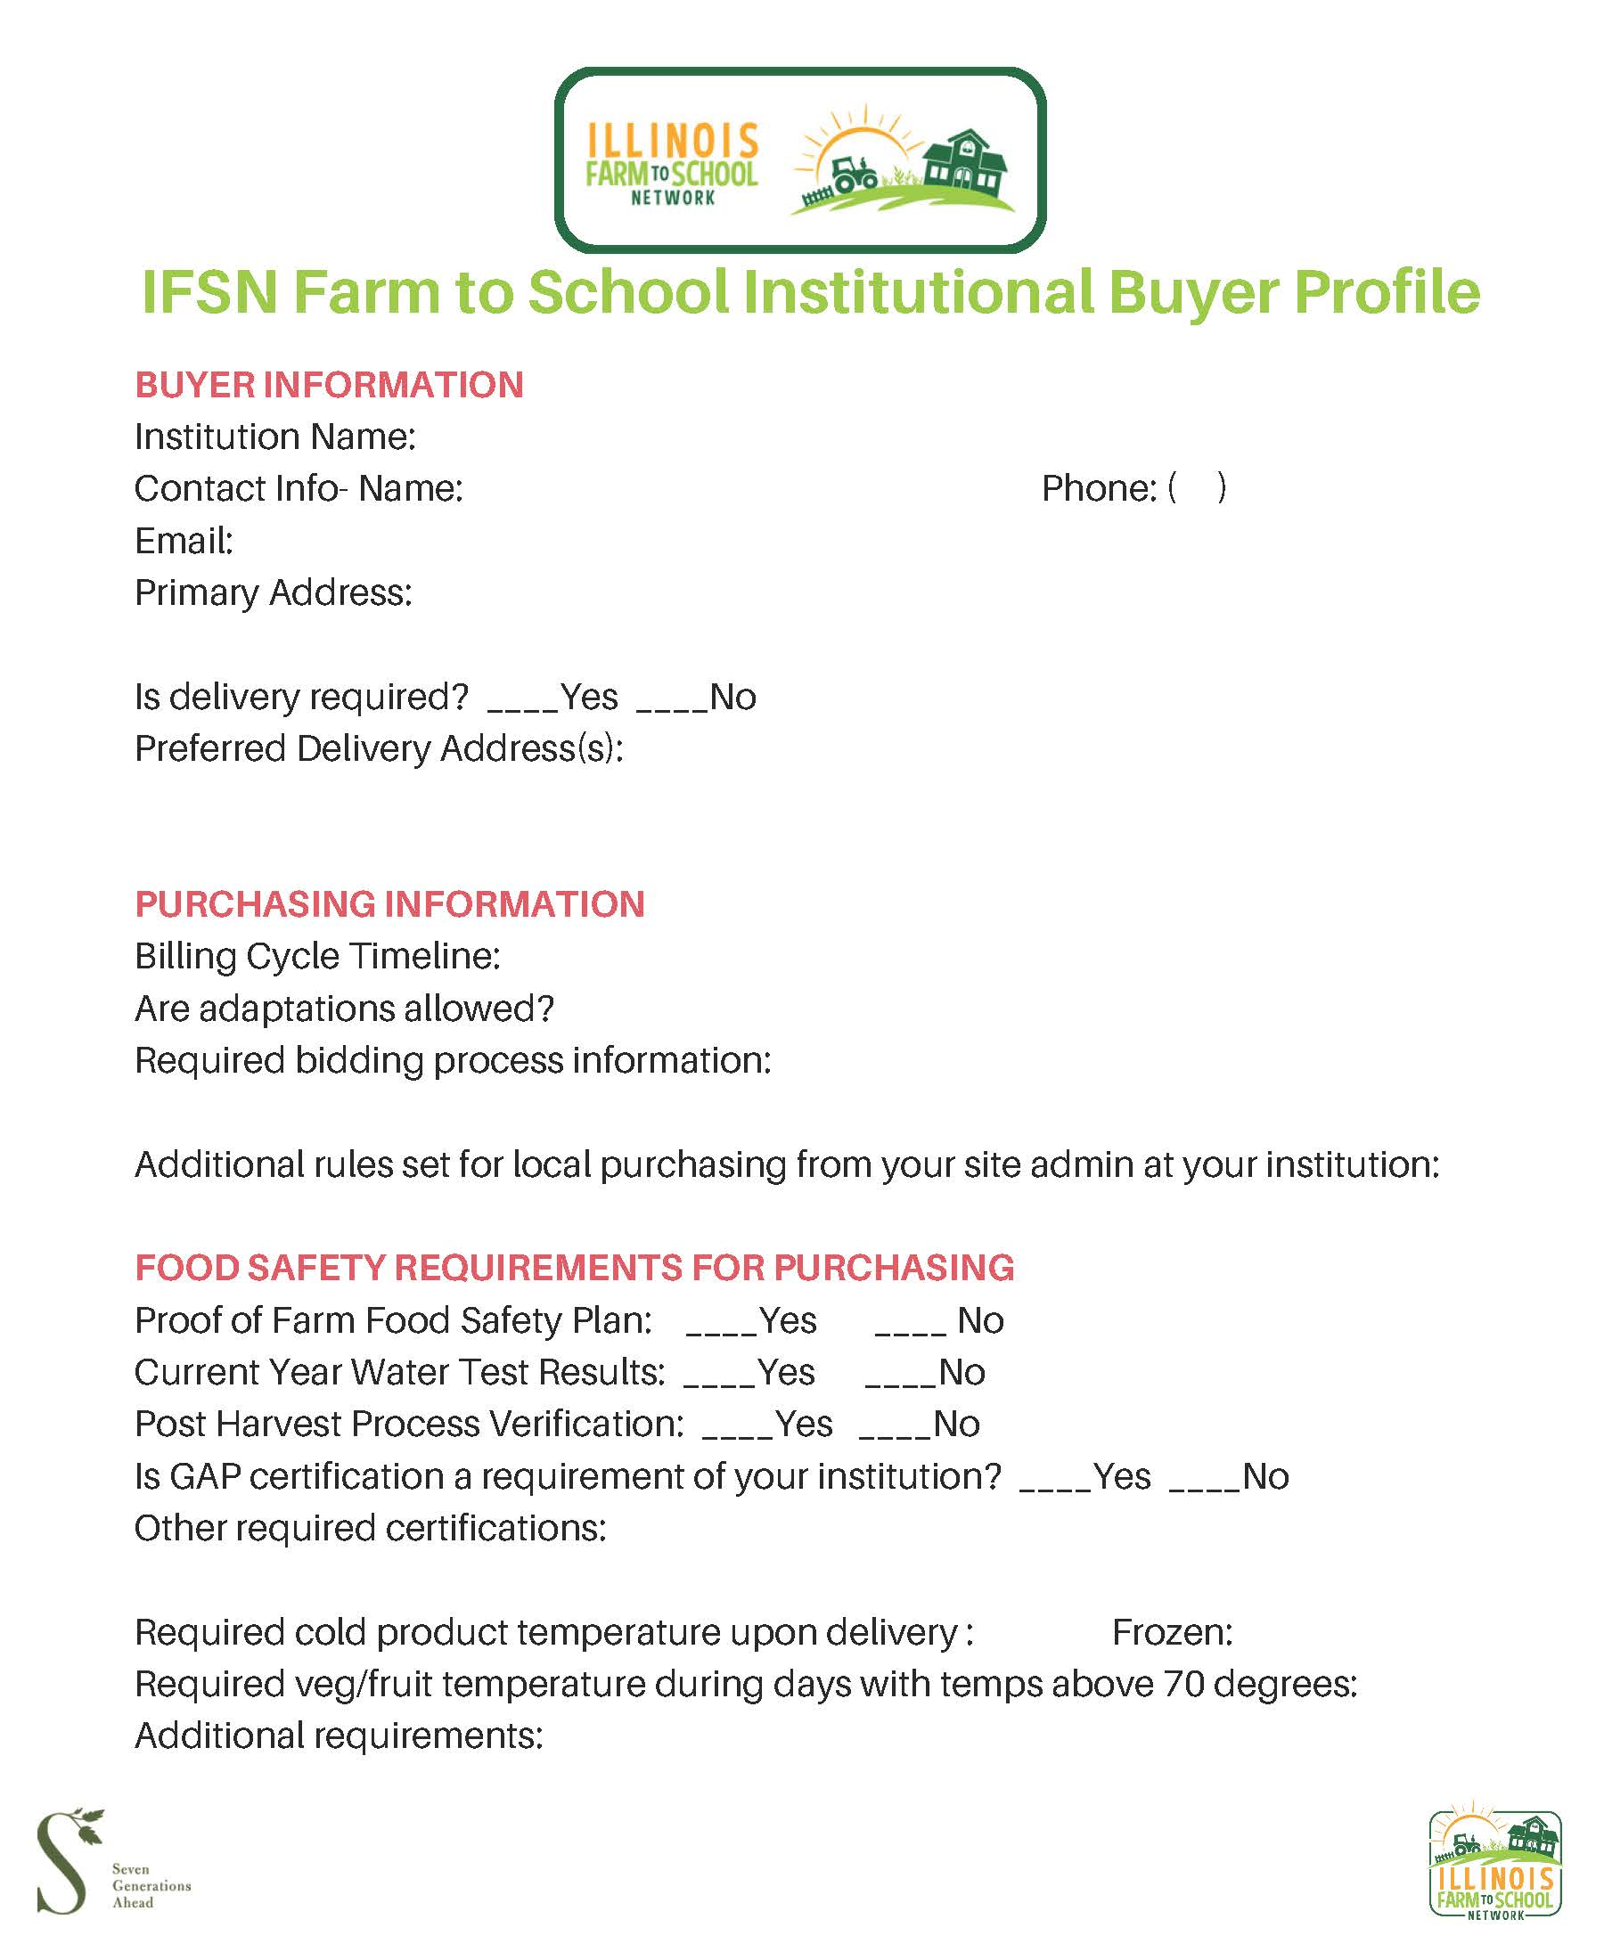
Step 5
Create a Buyer Profile to share all your information with farmers, food hubs and others.

Slide 9
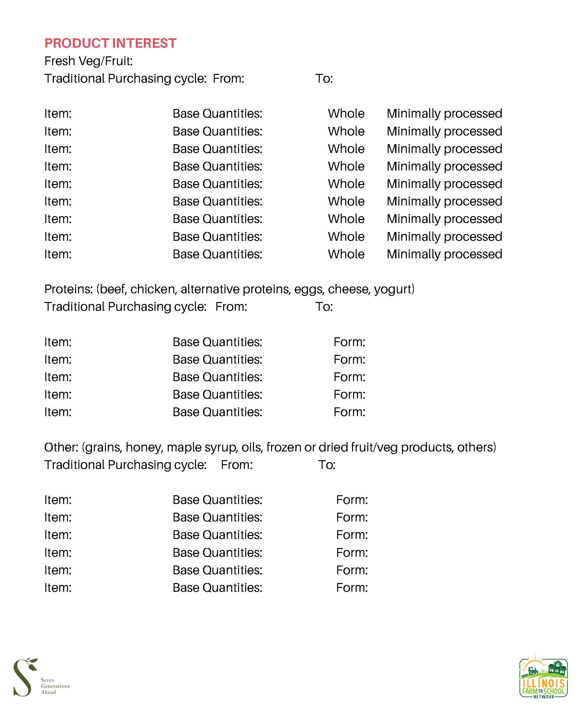
You can find the buyer profile in our Procurement Toolkit here: https://illinoisfarmtoschool.org/toolkit/local-food-procurement/
Contact us to add your profile to The Land Connection Local Food Purchasing Guide

Slide 10
Communicate with area farmers, processors and food hubs!
Communicate your interests and process
Connect to producers in your area.
Share the items you are interested in purchasing,.
Include the quantity, and the date(s), week(s) needed.
Specify there will be required information needed before purchase concerning food safety, post harvest process, liability insurance and delivery.

Slide 11
Procurement: Important Questions to Ask
Initial Contact:
Contact producers with bid specs utilizing the small purchase, micro purchase, or informal bid method with:
the items you are interested in purchasing,
the quantity, and the date(s), week(s) needed.
Specify there will be required information needed before purchase concerning food safety, post harvest process, insurance and delivery.

Slide 13
Thank you! Contact us: farmtoschool@sevengenerationsahead.org

